Slide 1
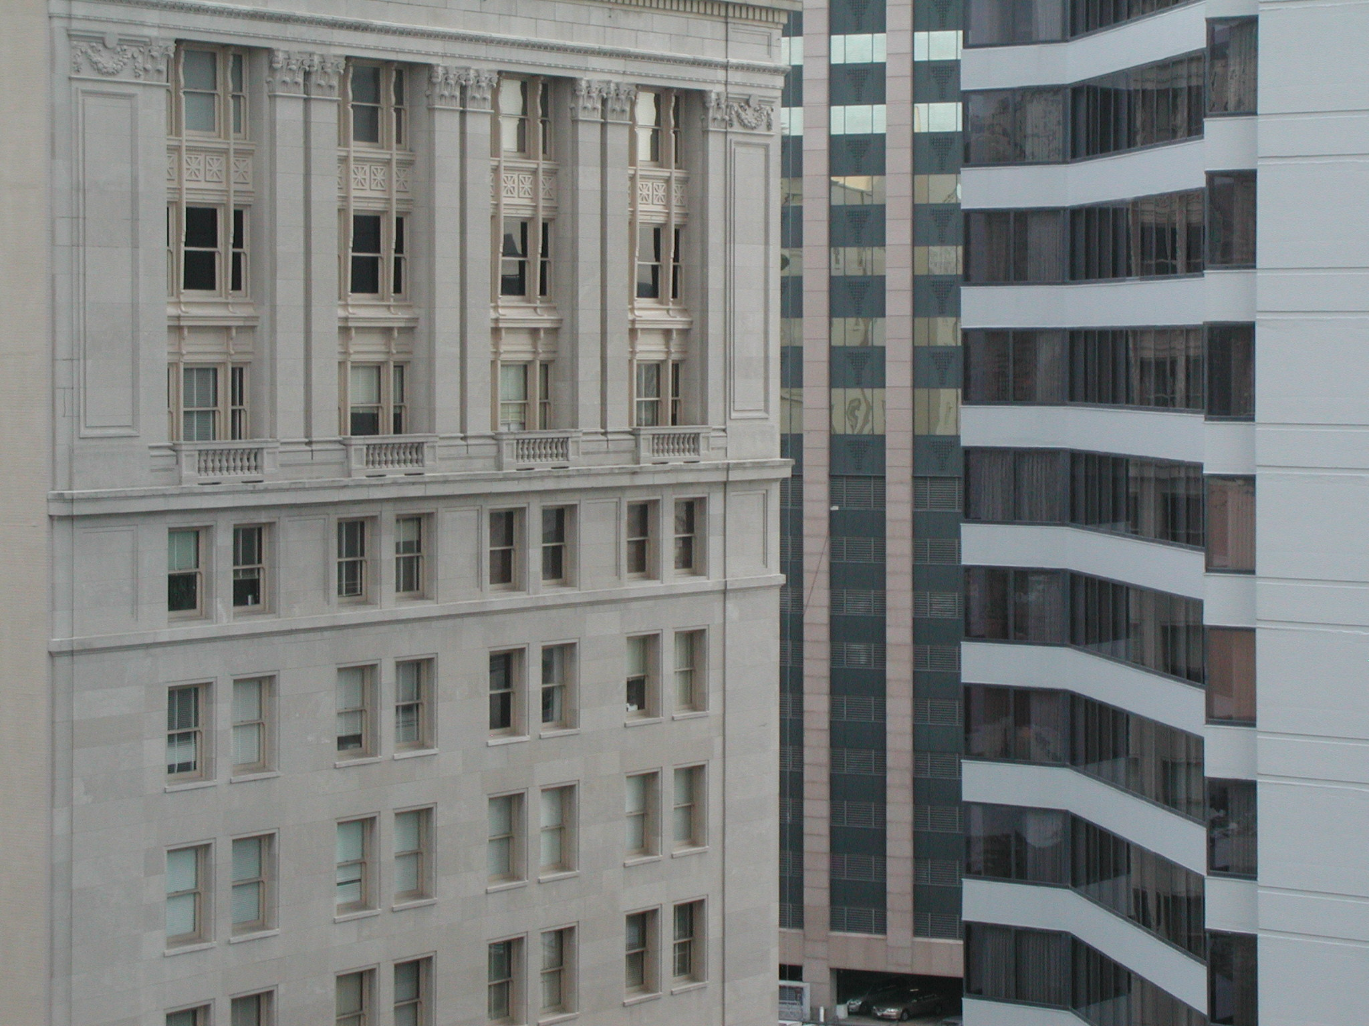

The Legal Architecture of Business Governance #2
Talk 17
LAW 459 003
BUSINESS ORGANIZATIONS
Allard School of Law, UBC
Fall, 2016
Jon Festinger Q.C.
Festinger Law & Strategy
http://bizorg.allard.ubc.ca
@jonfestinger
jon@fblawstrategy.com

Slide 2

Happy 1st Wednesday in Nov.
LAW 459 003
BUSINESS ORGANIZATIONS

Slide 3
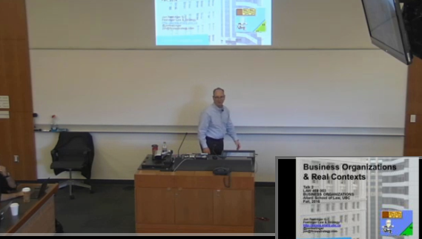
Lecture Capture Wednesday?

Slide 4

1st: News of the Week

Slide 5


Slide 6
2nd
Continuing with….

Slide 7
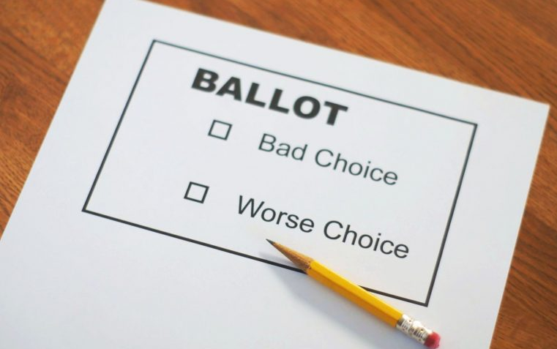
Unit 6: The Legal Architecture of Business Governance

Slide 8
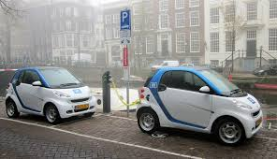
Constraining the use of the Corporate Vehicle

Slide 9
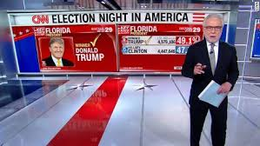
First CEO President of USA

Slide 10
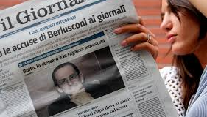
Precedent

Slide 11
Topics #1
General structure of the board/management/shareholder relationship.
How and to what extent management is subject to the direction of, and accountable to, the shareholders.
Investigating the nature of the corporate constitution and the internal architecture contemplated by corporate law.

Slide 12
Topics #2
The extent to which, by contract or otherwise, that architecture may be modified.
Corporate directors, their qualifications, disqualifications, election and removal and their compensation.
The “principle” of “majority rule” as well as its limits.

Slide 13

Academic Origins
Consequences of the separation of
ownership &
control (1932)

Slide 14
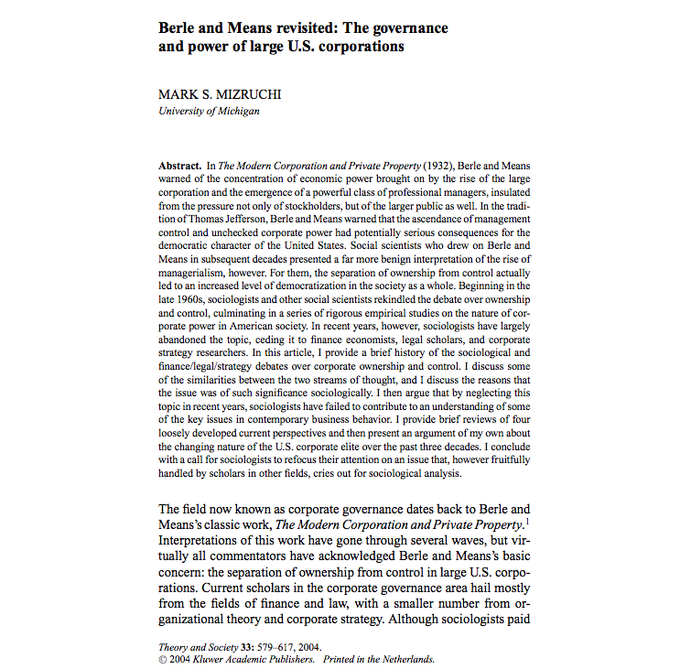

Slide 15
“The Modern Corporation and Private Property appeared in the early stages of the Great Depression, but it was more a product of the 1920s, or more generally, the period after 1890 that culminated in the stock market crash of 1929. Although the book is best known for the authors’ focus on ownership and control, that topic represents only one component of their discussion. Berle and Means began by arguing that capital in the United States had become heavily concentrated during the previous few decades and that this vested a relatively small number of companies with enormous power. As these firms grew, it became increasingly difficult for the original owners to maintain their majority stockholdings, and stocks became dispersed among a large number of small shareholders. The consequence of this dispersal, Berle and Means suggested, was the usurpation, by default, of power by the firm’s managers, those who ran the day-to-day affairs of the firm.”

Slide 16
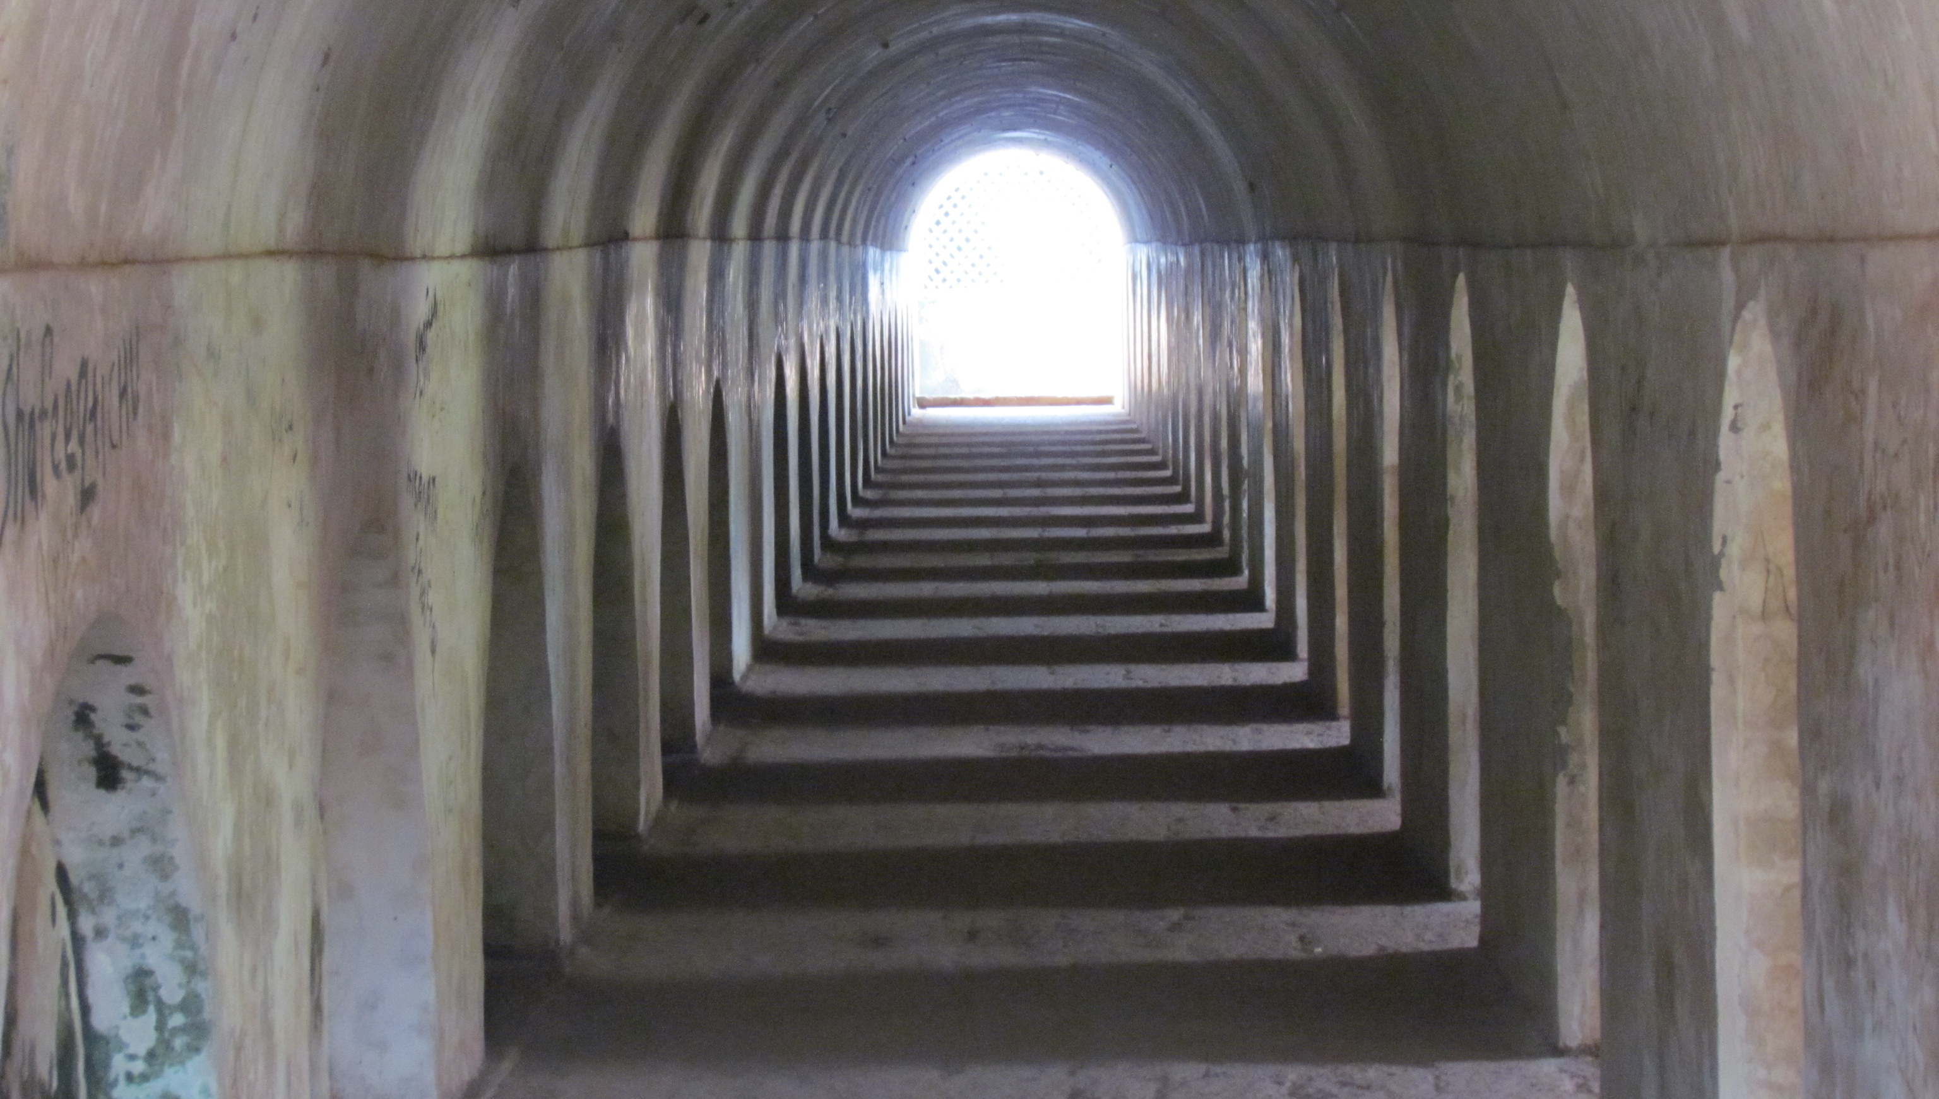
What is Good Governance?
Corridors of St. Angelo Fort, Malta

Slide 17
Governance
is not just
Compliance

Slide 18
Most of all…
The best governance
is almost…
INVISIBLE

Slide 19
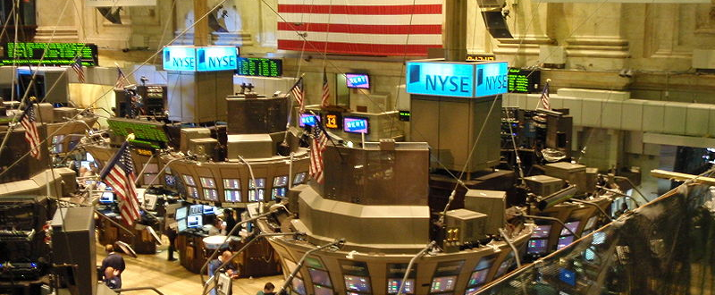
Corporate Governance is synonymizing with…Shareholders rights!

Slide 20
LOOK CLOSELY…
“Shareholders Rights”
leads directly to…………
→→→→→→→→→→→
$$$$$$$$$$$$$$$$$$$

Slide 21
On the other hand…consider
“Corpocracy”
= corporate + bureaucracy

Slide 22
BURORPORATE?

Slide 23
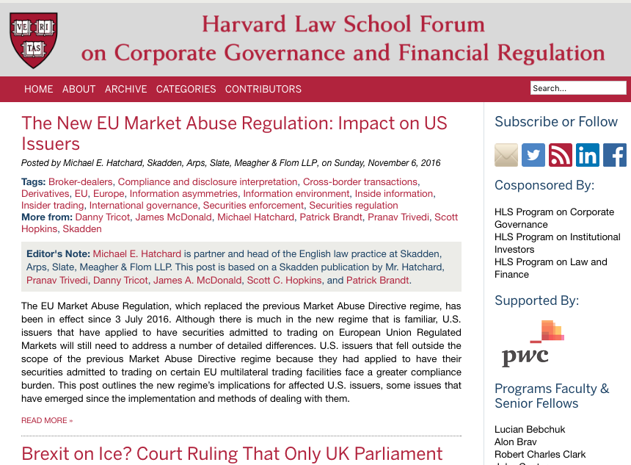
Resources?
Tag “Canada”

Slide 24
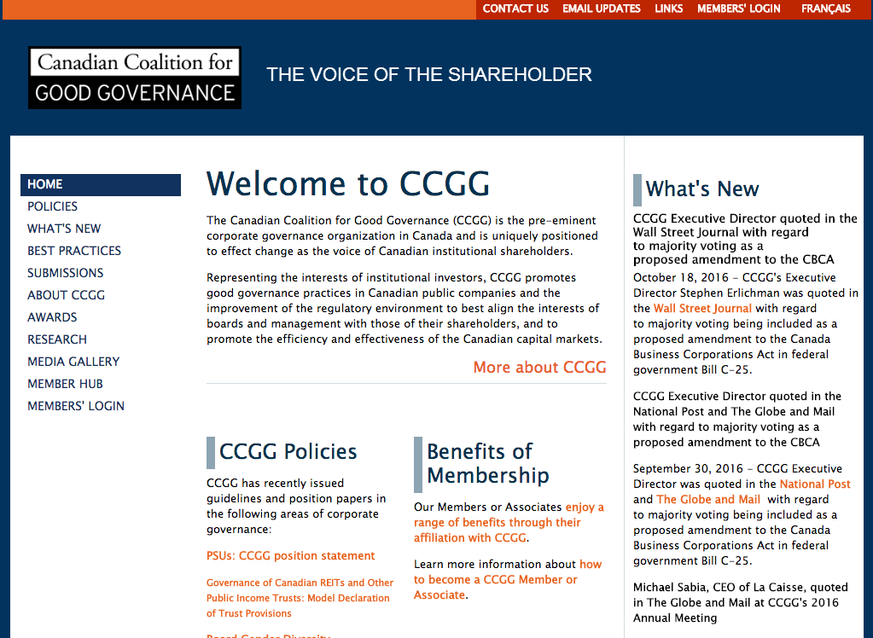

Slide 25


Slide 26


Slide 27
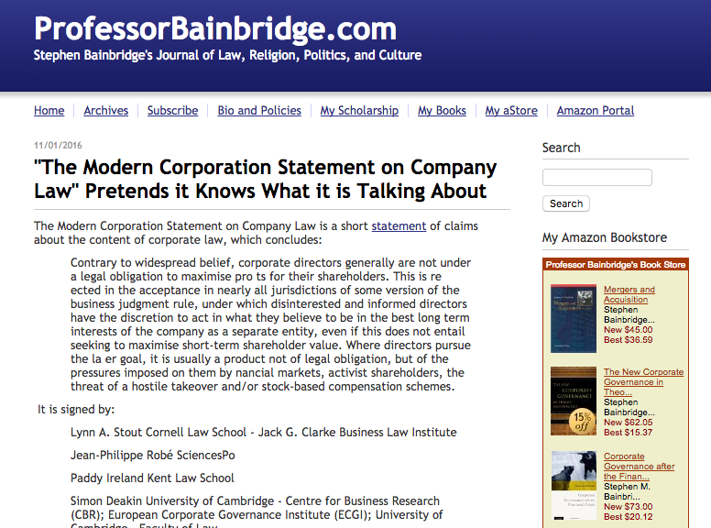

Slide 28


Slide 29
“Consider the following:
In 2010 the hedge fund titans Steve Roth and Bill Ackman bought 27% of J.C. Penney before having to disclose their position; Penney’s CEO, Mike Ullman, discovered the raid only when Roth telephoned him about it.
The proxy advisory firm Glass Lewis has announced that it will recommend a vote against the chairperson of the nominating and governance committee at any company that imposes procedural limits on litigation against the company, notwithstanding the consensus view among academics and practitioners that shareholder litigation has gotten out of control in the United States.
In 2012 JPMorgan Chase had no directors with risk expertise on the board’s risk committee—a deficiency that was corrected only after Bruno Iksil, the “London Whale,” caused $6 billion in trading losses through what JPM’s CEO, Jamie Dimon, called a “Risk 101 mistake.”

Slide 30
Allergan, a health care company, recently sought to impose onerous information requirements on efforts to call a special meeting of shareholders, and then promptly waived those requirements just before they would have been invalidated by the Delaware Chancery Court.
The corporate governance watchdog Institutional Shareholder Services (ISS) issued a report claiming that shareholders do better, on average, by voting for the insurgent slate in proxy contests; within hours, the law firm Wachtell, Lipton, Rosen & Katz issued a memorandum to clients claiming that the study was flawed.
The same ISS issues a “QuickScore” for every major U.S. public company, yet it won’t tell you how it calculates your company’s score or how you can improve it—unless you pay for this “advice.”

Slide 31
Principle #1: Boards Should Have the Right to Manage the Company for the Long Term
Principle #2: Boards Should Install Mechanisms to Ensure the Best Possible People in the Boardroom
Principle #3: Boards Should Give Shareholders an Orderly Voice

Slide 32

Pause

Slide 33
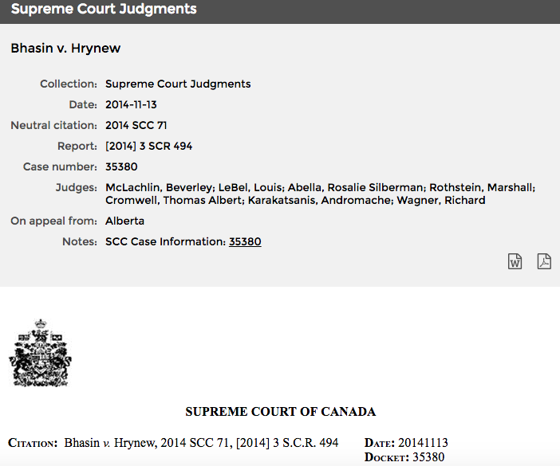
Applicability of the duty of good faith in commercial contracts

Slide 34
Not THE exam question…but…
“Corporations are democratic institutions” (Welling @page 98 of the casebook). Discuss.

Slide 35
Consider…
You literally BUY votes.
Non-voting shares and other corporate instruments without votes can be created with ease
Votes belong only to some specific shareholders not all affected parties

Slide 36
Introduction to Governance
Day-to-day business decisions are generally within the exclusive authority of the directors/ management. Shareholders do not have a role.
Contrast this to partnership where “Subject to any agreement express or implied between the partners… every partner may take part in the management of the partnership business;” ( 27 (e) of the Partnership Act, RSBC 1996)

Slide 37

Which hat?

Slide 38
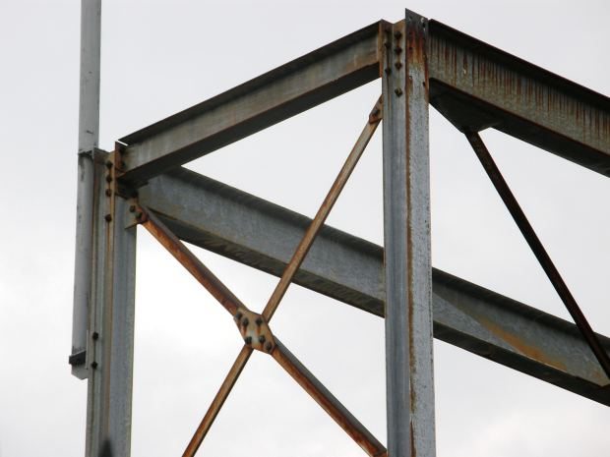
Legal
Framework

Slide 39
The Board of Directors chooses and supervises executives and management (BCBCA s.141(1); CBCA s. 121)
“BCBCA 141. (1) Subject to subsection (3) and to the memorandum and articles of a company, the directors may appoint officers and may specify their duties.”
“CBCA 121. Subject to the articles, the by-laws or any unanimous shareholder agreement,
(a) the directors may designate the offices of the corporation, appoint as officers persons of full capacity, specify their duties and delegate to them powers to manage the business and affairs of the corporation, except powers to do anything referred to in subsection 115(3);”

Slide 40
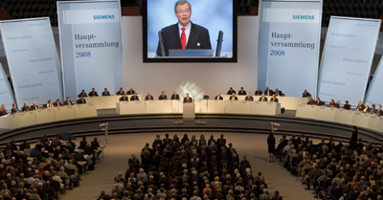
Shareholders
Siemens 2008 Shareholders Meeting

Slide 41
The Role of Shareholders #1…
…to elect directors and to remove them

Slide 42
The Role of Shareholders #2…
There are certain powers expressly reserved to shareholders by statute, e.g., amendments to the constitution, other “fundamental” changes such as approving sale of undertaking. BCBCA section 259; CBCA section 173 are some examples…

Slide 43
BCBCA Section 259
(1) A company may resolve to alter its articles
  (a) by the type of resolution specified by this Act,
  (b) if this Act does not specify the type of resolution, by the type of resolution specified by the articles, or
  (c) if neither this Act nor the articles specify the type of resolution, by a special resolution.
(2) A company may alter its articles to specify or change the majority of votes that is required to pass a special resolution, which majority must be at least 2/3 and not more than 3/4 of the votes cast on the resolution, if the shareholders resolve, by a special resolution, to make the alteration.
(3) A company may alter its articles to specify or change the majority of votes that is required for shareholders holding shares of a class or series of shares to pass a special separate resolution, which majority must be at least 2/3 and not more than 3/4 of the votes cast on the resolution, if
  (a) the shareholders resolve, by a special resolution, to make the alteration, and
  (b) shareholders holding shares of that class or series of shares consent by a special separate resolution of those shareholders…”

Slide 44
CBCA Section 173
(1) Subject to sections 176 and 177, the articles of a corporation may by special resolution be amended to
  (a) change its name;
  (b) change the province in which its registered office is situated;
  (c) add, change or remove any restriction on the business or businesses that the corporation may carry on;
  (d) change any maximum number of shares that the corporation is authorized to issue;
  (e) create new classes of shares;
  (f) reduce or increase its stated capital, if its stated capital is set out in the articles;
  (g) change the designation of all or any of its shares, and add, change or remove any rights, privileges, restrictions and conditions, including rights to accrued dividends, in respect of all or any of its shares, whether issued or unissued;
  (h) change the shares of any class or series, whether issued or unissued, into a different number of shares of the same class or series or into the same or a different number of shares of other classes or series;

Slide 45
CBCA Section 173 (continued)
(i) divide a class of shares, whether issued or unissued, into series and fix the number of shares in each series and the rights, privileges, restrictions and conditions thereof;
(j) authorize the directors to divide any class of unissued shares into series and fix the number of shares in each series and the rights, privileges, restrictions and conditions thereof;
(k) authorize the directors to change the rights, privileges, restrictions and conditions attached to unissued shares of any series;
(l) revoke, diminish or enlarge any authority conferred under paragraphs (j) and (k);
(m) increase or decrease the number of directors or the minimum or maximum number of directors, subject to sections 107 and 112;
(n) add, change or remove restrictions on the issue, transfer or ownership of shares; or
(o) add, change or remove any other provision that is permitted by this Act to be set out in the articles.

Slide 46
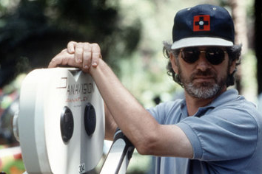
Next class: Directors in depth +

Slide 47

Am I an VLC (Vicariously Liable Cat)?

