Slide 1


The Legal Architecture of Business Governance #3
Talk 18
LAW 459 003
BUSINESS ORGANIZATIONS
Allard School of Law, UBC
Fall, 2016
Jon Festinger Q.C.
Festinger Law & Strategy
http://bizorg.allard.ubc.ca
@jonfestinger
jon@fblawstrategy.com

Slide 2
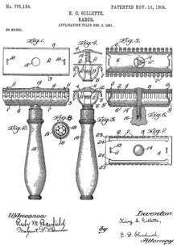
Happy November 14
LAW 459 003
BUSINESS ORGANIZATIONS
112 years ago today King C. Gillette
patents the Gillette razor blade

Slide 3
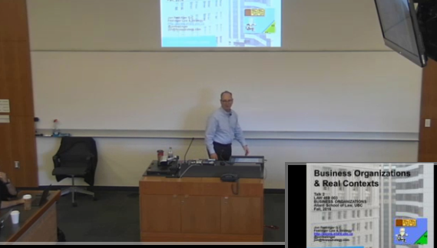
Lecture Capture Monday

Slide 4

1st: Assignment #1

Slide 5
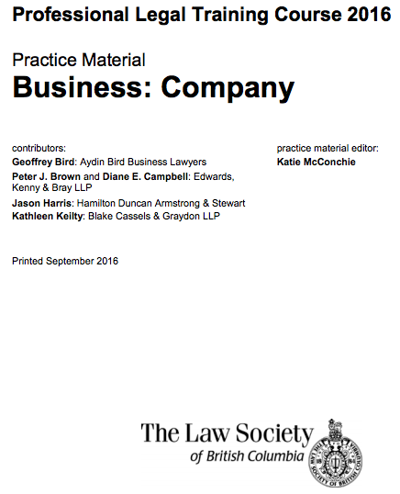
2nd: Useful Resource
https://www.lawsociety.bc.ca/docsbecoming/material/Company.pdf

Slide 6
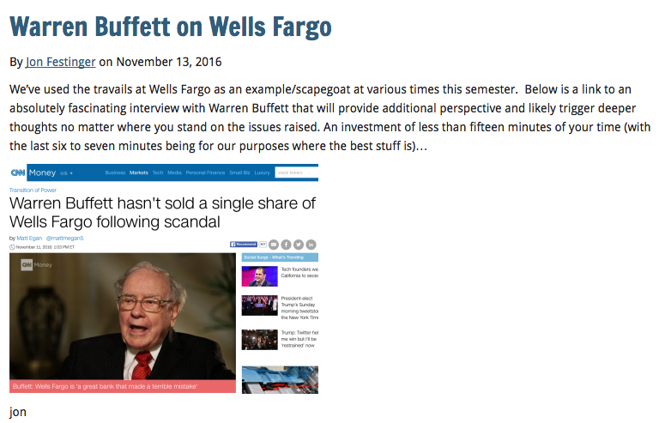
3rd: News of the Week

Slide 7
4th
Continuing with….

Slide 8
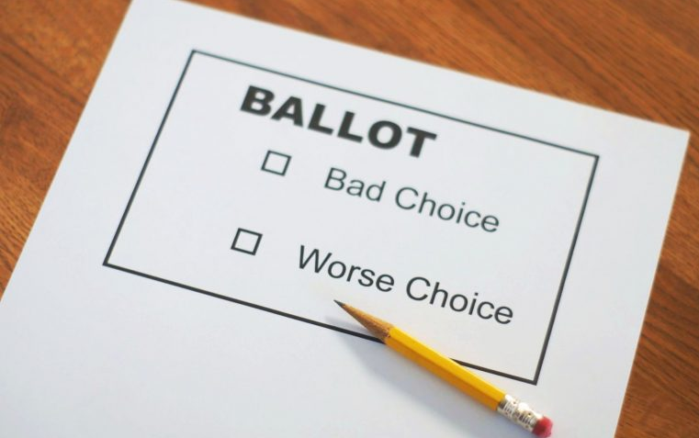
Unit 6: The Legal Architecture of Business Governance

Slide 9

Constraining the use of the Corporate Vehicle

Slide 10
Topics #1
General structure of the board/management/shareholder relationship.
How and to what extent management is subject to the direction of, and accountable to, the shareholders.
Investigating the nature of the corporate constitution and the internal architecture contemplated by corporate law.

Slide 11
Topics #2
The extent to which, by contract or otherwise, that architecture may be modified.
Corporate directors, their qualifications, disqualifications, election and removal and their compensation.
The “principle” of “majority rule” as well as its limits.

Slide 12

Academic Origins
Consequences of the separation of
ownership &
control (1932)

Slide 13
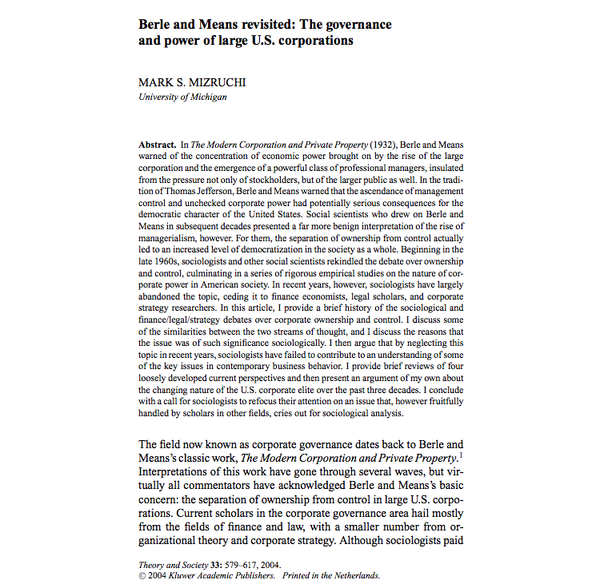

Slide 14
“The Modern Corporation and Private Property appeared in the early stages of the Great Depression, but it was more a product of the 1920s, or more generally, the period after 1890 that culminated in the stock market crash of 1929. Although the book is best known for the authors’ focus on ownership and control, that topic represents only one component of their discussion. Berle and Means began by arguing that capital in the United States had become heavily concentrated during the previous few decades and that this vested a relatively small number of companies with enormous power. As these firms grew, it became increasingly difficult for the original owners to maintain their majority stockholdings, and stocks became dispersed among a large number of small shareholders. The consequence of this dispersal, Berle and Means suggested, was the usurpation, by default, of power by the firm’s managers, those who ran the day-to-day affairs of the firm.”

Slide 15

Corporate Governance is synonymizing with…Shareholders rights!

Slide 16




LOOK CLOSELY…
Is “Shareholders Rights” really all about

Slide 17
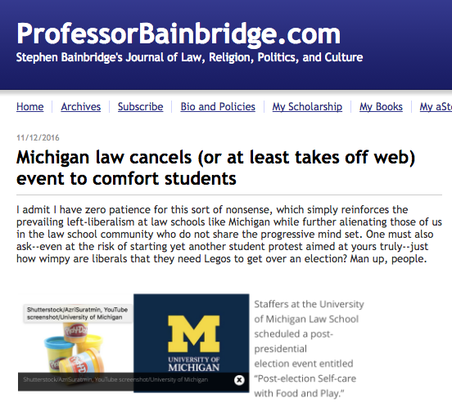

Slide 18


Slide 19
Principle #1: Boards Should Have the Right to Manage the Company for the Long Term
End earnings guidance.
Bring back a variation on the staggered board.
Install exclusive forum provisions (usually Delaware).

Slide 20
Principle #2: Boards Should Install Mechanisms to Ensure the Best Possible People in the Boardroom
Require meaningful director evaluations.
Consider shareholder proxy access (shareholders with a significant ownership stake in the company would have the right to put director candidates on the company’s ballot).

Slide 21
Principle #3: Boards Should Give Shareholders an Orderly Voice
“Under a Corporate Governance 2.0 system, boards would get early warning of lightning-strike attacks. One way to do this would be with what I call an “advance notice” poison pill—a pill with a 5% threshold but also an exemption: Any shareholders that disclosed their positions within two days of crossing the threshold would avoid triggering the pill and could continue buying shares without being diluted.”

Slide 22

Pause

Slide 23
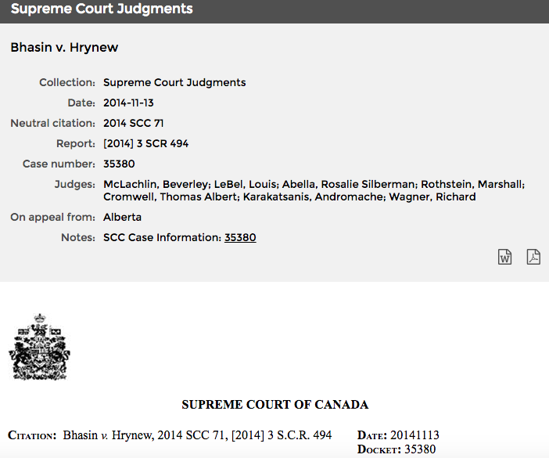
Applicability of the duty of good faith in commercial contracts

Slide 24
Introduction to Governance
Day-to-day business decisions are generally within the exclusive authority of the directors/ management. Shareholders do not have a role.
Contrast this to partnership where “Subject to any agreement express or implied between the partners… every partner may take part in the management of the partnership business;” ( 27 (e) of the Partnership Act, RSBC 1996)

Slide 25
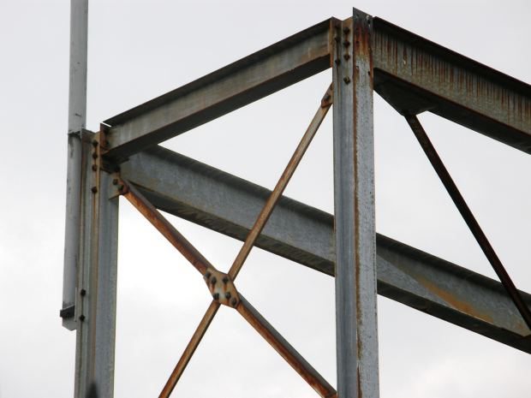
Legal
Framework

Slide 26
Keep in mind #1…
“Corporations are democratic institutions” (Welling @page 98 of the casebook). Discuss.

Slide 27

Keep in mind #2…Which hat?

Slide 28
The Board of Directors chooses and supervises executives and management (BCBCA s.141(1); CBCA s. 121)
“BCBCA 141. (1) Subject to subsection (3) and to the memorandum and articles of a company, the directors may appoint officers and may specify their duties.”
“CBCA 121. Subject to the articles, the by-laws or any unanimous shareholder agreement,
(a) the directors may designate the offices of the corporation, appoint as officers persons of full capacity, specify their duties and delegate to them powers to manage the business and affairs of the corporation, except powers to do anything referred to in subsection 115(3);”

Slide 29
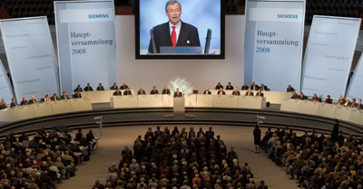
Shareholders
Siemens 2008 Shareholders Meeting

Slide 30
The Role of Shareholders #1…
…to elect directors and to remove them

Slide 31
The Role of Shareholders #2…
There are certain powers expressly reserved to shareholders by statute, e.g., amendments to the constitution, other “fundamental” changes such as approving sale of undertaking. BCBCA section 259; CBCA section 173 are some examples…

Slide 32
BCBCA Section 259
(1) A company may resolve to alter its articles
  (a) by the type of resolution specified by this Act,
  (b) if this Act does not specify the type of resolution, by the type of resolution specified by the articles, or
  (c) if neither this Act nor the articles specify the type of resolution, by a special resolution.
(2) A company may alter its articles to specify or change the majority of votes that is required to pass a special resolution, which majority must be at least 2/3 and not more than 3/4 of the votes cast on the resolution, if the shareholders resolve, by a special resolution, to make the alteration.
(3) A company may alter its articles to specify or change the majority of votes that is required for shareholders holding shares of a class or series of shares to pass a special separate resolution, which majority must be at least 2/3 and not more than 3/4 of the votes cast on the resolution, if
  (a) the shareholders resolve, by a special resolution, to make the alteration, and
  (b) shareholders holding shares of that class or series of shares consent by a special separate resolution of those shareholders…”

Slide 33
CBCA Section 173
(1) Subject to sections 176 and 177, the articles of a corporation may by special resolution be amended to
  (a) change its name;
  (b) change the province in which its registered office is situated;
  (c) add, change or remove any restriction on the business or businesses that the corporation may carry on;
  (d) change any maximum number of shares that the corporation is authorized to issue;
  (e) create new classes of shares;
  (f) reduce or increase its stated capital, if its stated capital is set out in the articles;
  (g) change the designation of all or any of its shares, and add, change or remove any rights, privileges, restrictions and conditions, including rights to accrued dividends, in respect of all or any of its shares, whether issued or unissued;
  (h) change the shares of any class or series, whether issued or unissued, into a different number of shares of the same class or series or into the same or a different number of shares of other classes or series;

Slide 34
CBCA Section 173 (continued)
(i) divide a class of shares, whether issued or unissued, into series and fix the number of shares in each series and the rights, privileges, restrictions and conditions thereof;
(j) authorize the directors to divide any class of unissued shares into series and fix the number of shares in each series and the rights, privileges, restrictions and conditions thereof;
(k) authorize the directors to change the rights, privileges, restrictions and conditions attached to unissued shares of any series;
(l) revoke, diminish or enlarge any authority conferred under paragraphs (j) and (k);
(m) increase or decrease the number of directors or the minimum or maximum number of directors, subject to sections 107 and 112;
(n) add, change or remove restrictions on the issue, transfer or ownership of shares; or
(o) add, change or remove any other provision that is permitted by this Act to be set out in the articles.

Slide 35
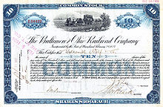
What/who is a shareholder?
BCBCA: “shareholder”…means a person whose name is entered in a securities register of a company as a registered owner of a share of the company…”
No comparable provision in CBCA.

Slide 36
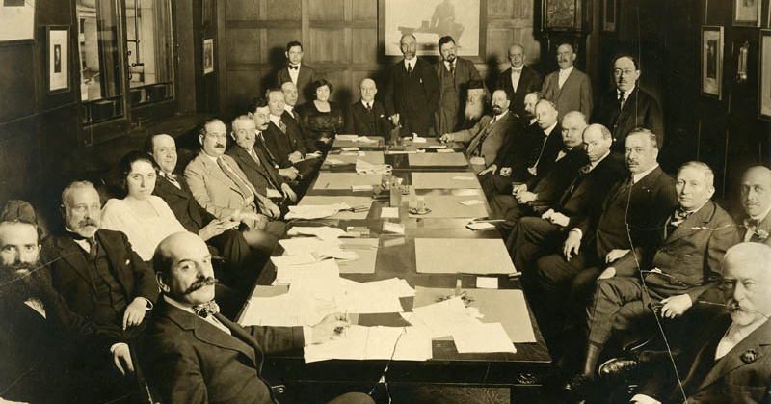
DIVISION OF POWERS BETWEEN DIRECTORS AND SHAREHOLDERS
BCBCA 136 (1) The directors of a company must, subject to this Act, the regulations and the memorandum and articles of the company, manage or supervise the management of the business and affairs of the company.”

Slide 37
Standard form BC Articles provide…
“16.1 Powers of Management
The directors must, subject to the Business Corporations Act and these Articles, manage or supervise the management of the business and affairs of the Company and have the authority to exercise all such powers of the Company as are not, by the Business Corporations Act or by these Articles, required to be exercised by the shareholders of the Company.”

Slide 38
Canadian Jorex Ltd. v. 477749 Alberta Ltd. (1991) 85 Alta. L.R. (2d) 313
Issue: Do the directors of a federal company have the power to cancel a special meeting called by them?
Facts: A special meeting of Canadian Jorex was called for Dec. 10, 1991. By notice of Nov. 27, 1991, the Board of Directors of Jorex purported to cancel the special meeting.
Argument: Jorex contended that because nothing in its bylaws, the CBCA, or its Shareholders Agreement restricted the directors' ability to cancel special meetings, the directors had that power given the corporate model of the CBCA.

Slide 39
Rationale: Jorex argued that s. 102 of the CBCA which says that "the directors shall manage the business and affairs of a corporation". S. 2(1) defines "affairs” as "the relationships among a corporation, its affiliates and the shareholders, directors and officers of such bodies corporate". S. 16(1) provides "it is not necessary for a bylaw to be passed in order to confer any particular power on the corporation or its directors”.
Contra: That the Jorex bylaws specified that only the Jorex shareholders may adjourn the meeting once convened. Argument was that “cancellation” prior was tantamount to “adjournment”.

Slide 40
Decision: “One must distinguish between a power which the directors of a corporation enjoy and the manner in which that power is exercised. Here, we are concerned solely with the first question. Counsel did not suggest that the Jorex directors exercised the power to cancel the December special meeting for any improper purpose. Of course, if the directors had done so, then that might have been a sufficient reason to treat the purported exercise of the power as having been of no force or effect: Teck Corporation Ltd. v. Millar [1973] 2 W.W.R. 385 (B.C.S.C.)…Under the corporate model adopted by the CBCA, the residual power to manage the corporation's affairs rests with the directors. This power is given by statute and is not derived from the delegation of powers by the shareholders. This must be contrasted with the British model of corporate law under which the directors enjoy only those powers delegated to them by the shareholders…”

Slide 41
Statutory v. Contractual models
CBCA corporate model = Residual power to manage the corporation’s affairs rests with the directors.
This power is given by statute and is not derived from the delegation of powers by the shareholders (through by-laws).
To be contrasted with the British model of corporate law under which the directors enjoy only those powers delegated to them by the shareholders (contractual).

Slide 42
Northern Minerals Investment Corp. v. Mundoro Capital Inc. 2012 BCSC 1090
A key was that there no evidence that the board was not acting in the best interests of the shareholder: “The actions of the board in this instance in creating an advance notice policy have not been shown to having been done to “influence or preclude” a proxy contest but rather to insure that all shareholders are made aware that a proxy contest exists. No evidence has been put forward that the directors are not behaving reasonably.”

Slide 43
Facts:
Original notice of AGM to be held on June 26 of “Mundoro Capital Inc.” a BC Company with a “record date” of May 22.
June 11 press release announced that the directors of Mundoro Capital Inc. had adopted an “Advance Notice Policy” by which shareholders were required to submit nominations for directors by a deadline.
June 14 press release announced that the Annual General Meeting was being postponed to August 27, with the record date changed to July 27. The business of the meeting was to also include shareholder approval of “Advance Notice Policy”.
Northern Minerals Investment Corp., a shareholder in Mundoro Capital Inc. sought to restrain the postponement or adjournment of the June 26 AGM, and an order from the court preventing any change to the record date.

Slide 44
Northern Minerals Investment Corp., argued the contractarian position that under the BCCA directors have only those powers granted to them by the articles of the company. In other words, that directors’ powers must be expressly conferred and that directors under the British Columbia Business Corporations Act have no residual powers. It was argued that the scheme of the CBCA is different from the BC Act by giving directors residual powers the decision and that Canadian Jorex Ltd. v. 477749 Alberta Ltd. would be inapplicable.
Mundoro Capital Inc. argued that section 15.1 of the articles of Mundoro Capital Inc. specifically and expressly reserved to the directors of Mundoro Capital Inc. all residual powers.

Slide 45
15.1(of the Articles):
“Powers of Management. The directors must, subject to the Business Corporations Act and these Articles, manage or supervise the management of the business and affairs of the Company and have the authority to exercise all such powers of the Company as are not, by the Business Corporations Act or by these Articles, required to be exercised by the shareholders of the Company.”

Slide 46
Punnett J. found the articles and Act, and the residual “basket clause” in the articles and the Act are to be read as was done the case in Canadian Jorex Ltd. v. 477749 Alberta Ltd. and the case of Oppenheimer & Co. v. United Grain Growers Ltd. (1997) 2 W.W.R. 9 (Q.B.). It was held that as a matter of contractual interpretation the directors’ powers flow from the Act and articles in which the directors are in fact granted residual powers. In this way the court treated the BC and CBCA models as substantially similar. Both are accordingly, essentially, board-centric.

Slide 47
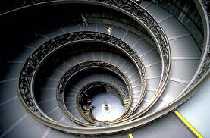
Next Topic: LIMITATIONS OF BOARD-CENTRIC MODEL AND RE-DESIGNING THE ARCHITECTURE

Slide 48
Close Corporations (not public)
Same people are shareholders, directors and officers.
In corporations with few shareholders, the shareholders will tend to elect themselves as directors
As well shareholder/directors will typically select themselves as officers.
Accordingly shareholders often view themselves as running the business as owners – just as with partners.

Slide 49

Examples of close corps.:

Slide 50

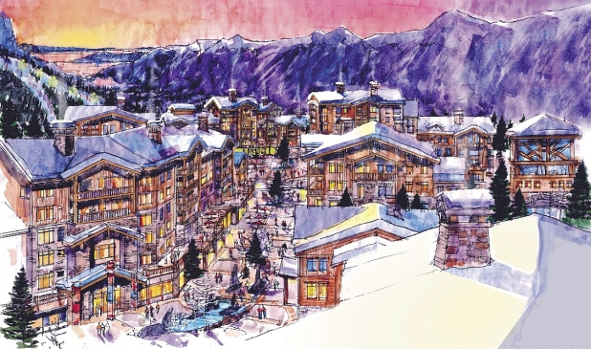


Slide 51
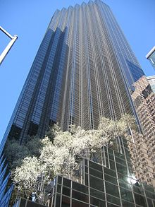

& of recent note in the U.S.A.

Slide 52
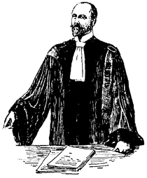
Very different counsel experience

Slide 53
Publicly Held Corporations
The theoretical model: Power flows from the shareholders, who decide who will be directors, to directors, who choose officers and set policies, to the officers who implement the policies.
The reality: In practice, the officers, particularly the chief executive officer (CEO), commonly decide who will be the directors and what policies the corporation will pursue.

Slide 54
Why do the theoretical model and the reality diverge? Four possible reasons:
Shareholders in publicly held corporations are typically “rationally apathetic”.
Logistical and other costs of changing management is high. Rewards to changing management often are low. Usually just cheaper and easier to just sell your shares.
Incumbent shareholders, directors and officers effectively control the “voting machinery”.
Superstar CEO’s are a counterweight to the theoretical model where the locus of the power of appointment is intended to be in the shareholders.

Slide 55
Re-read BCBCA Section 137 (1)
Powers of directors may be transferred
137 (1) …the articles of a company may transfer, in whole or in part, the powers of the directors to manage or supervise the management of the business and affairs of the company to one or more other persons.

Slide 56
Effect…
“(2) If the whole or any part of the powers of the directors is transferred in the manner contemplated by subsection (1),
  (a) the persons to whom those powers are transferred have all the rights, powers, duties and liabilities of the directors of the company, whether arising under this Act or otherwise, in relation to and to the extent of the transfer, including any defences available to the directors, and
  (b) the directors are relieved of their rights, powers, duties and liabilities to the same extent.”

Slide 57

Next: Directors in depth

Slide 58

Am I an VLC (Vicariously Liable Cat)?

