Slide 1


The Legal Architecture of Business Governance #4
Talk 19
LAW 459 003
BUSINESS ORGANIZATIONS
Allard School of Law, UBC
Fall, 2016
Jon Festinger Q.C.
Festinger Law & Strategy
http://bizorg.allard.ubc.ca
@jonfestinger
jon@fblawstrategy.com

Slide 2
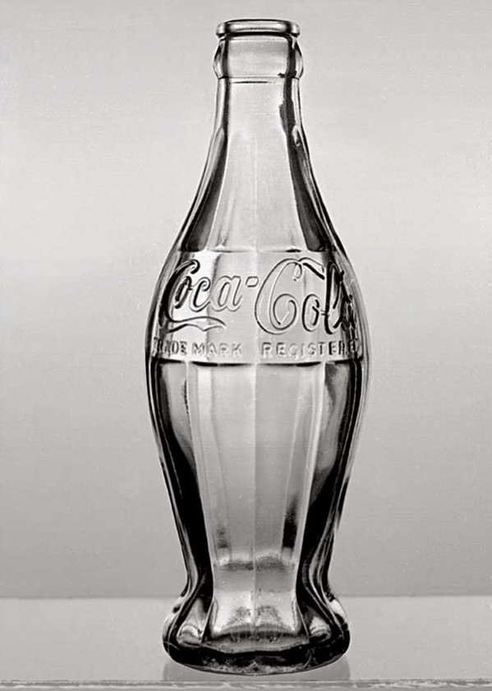
Happy November 16
LAW 459 003
BUSINESS ORGANIZATIONS
101 years ago today Coca-Cola had its prototype for a contoured bottle patented. The bottle made its commercial debut the next year.

Slide 3
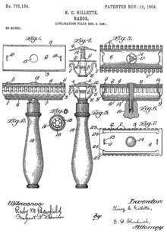
Follow-up
112 years ago Monday
King C. Gillette patents
the Gillette razor blade*

Slide 4
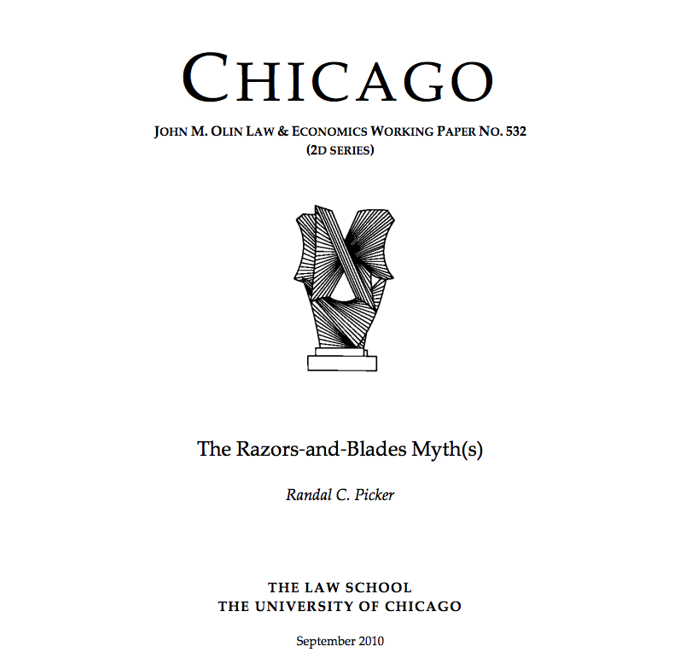
* My comments of last class mostly hold up
except the pivot was not in the 1980’s.

Slide 5
“But, unfortunately - at least for the razors-and-blades story - the best-available evidence suggests just the opposite. Gillette set an initial price of $5 for the razor with an initial set of blades and used every available legal means to ensure that its dealers didn’t undercut that price. $5 was a particularly high price - roughly one third of the average weekly industrial wage at the time - a premium product like today’s iPod, except even more expensive. Gillette maintained a high price throughout the life of the patents and it was only as the patents were ready to expire that Gillette switched strategies. And Gillette’s profits did jump after it switched strategies and started selling more razors and more blades, suggesting that the expiration of the 1904 patents was actually good news for Gillette and that there was some truth in razors-and-blades, even if that had been lost on Gillette itself during the life of the 1904 patents.”

Slide 6
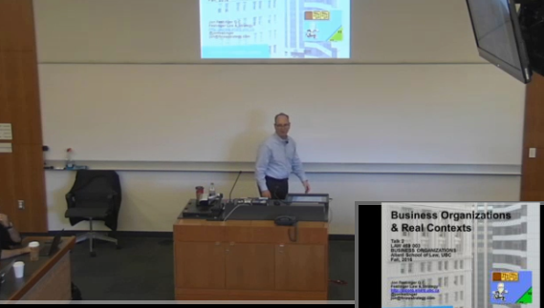
Lecture Capture Wednesday!

Slide 7

1st:return of Assignment #1

Slide 8

If there is a bit of yellow stuff on your assignment…my apologies…

Slide 9
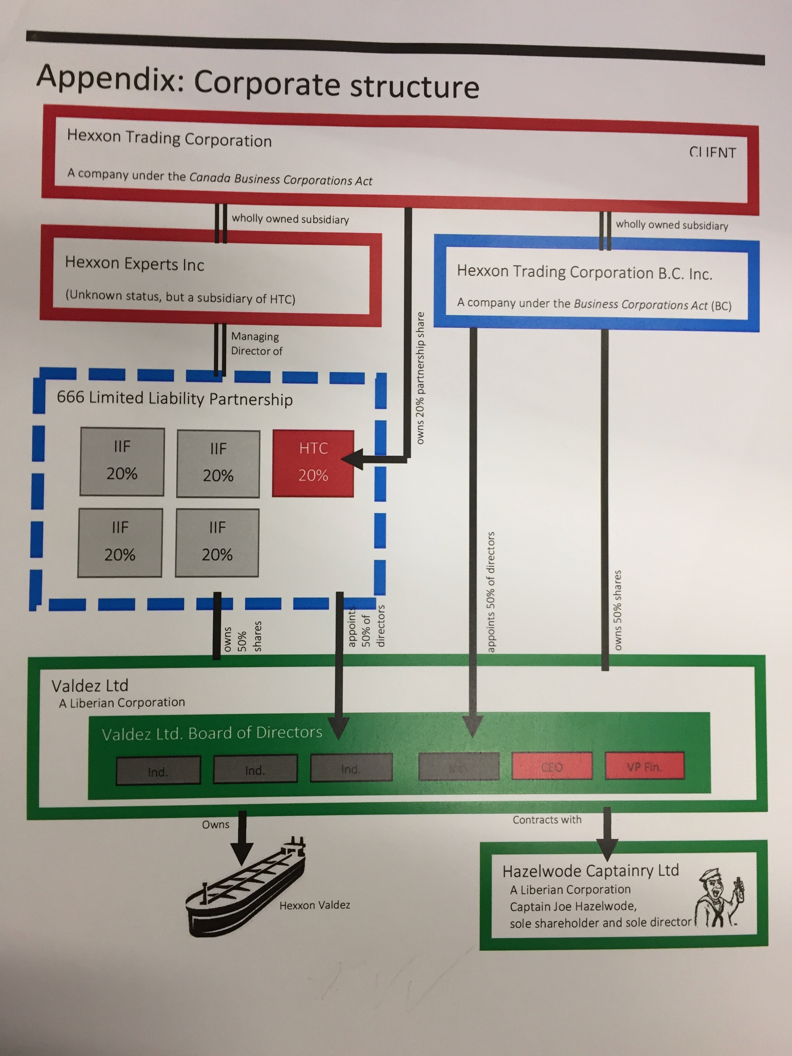
If I were the partner…

Slide 10
2nd: Reminder
Second assignment due Monday November 28, 2016 by 9 AM (or at beginning of class)

Slide 11
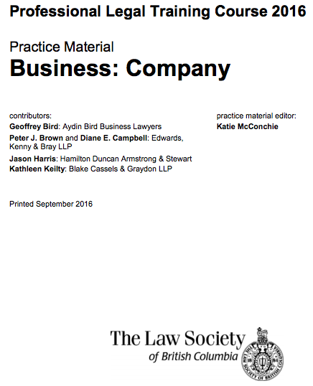
3rd: Useful Resource (reminder)
https://www.lawsociety.bc.ca/docsbecoming/material/Company.pdf

Slide 12
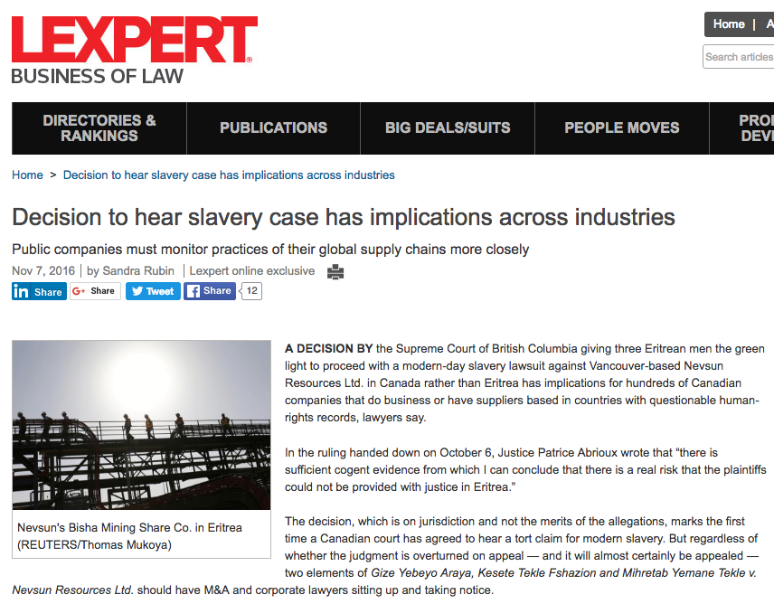
4th: News of the Week

Slide 13
5th
Completing….

Slide 14
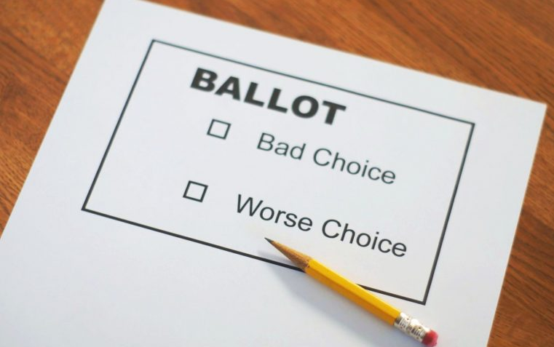
Unit 6:
The Legal Architecture of Business Governance

Slide 15
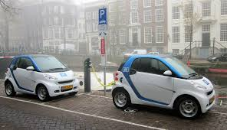
Constraining the use of the Corporate Vehicle ?

Slide 16
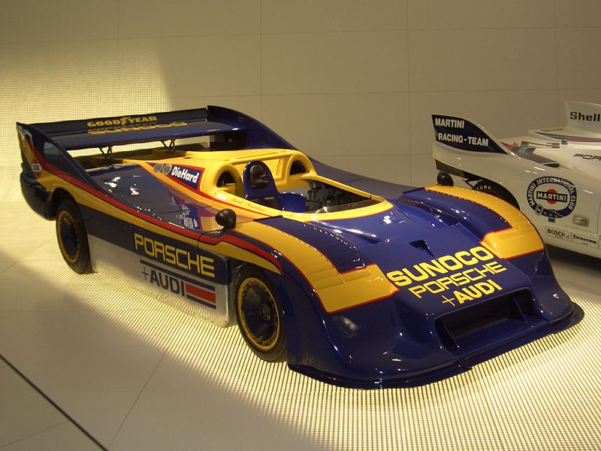
A: Not much

Slide 17

Academic Origins
Consequences of the separation of
ownership &
control (1932)

Slide 18

Corporate Governance is synonymizing with…Shareholders rights!

Slide 19
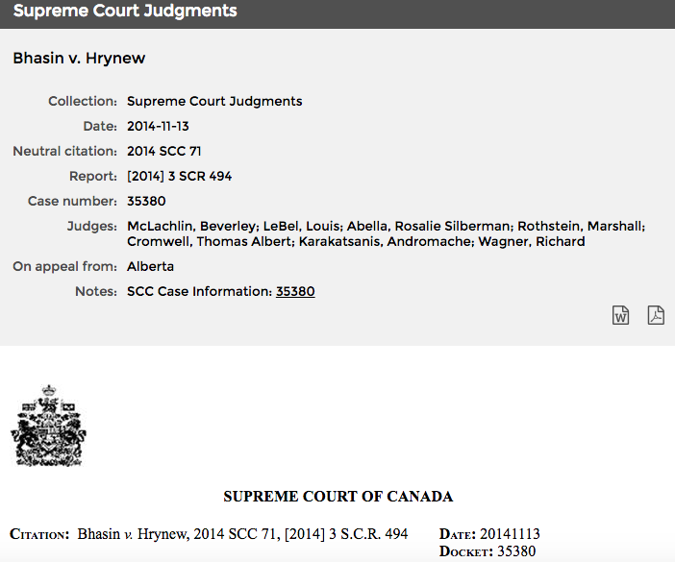
Applicability of the duty of good faith in commercial contracts

Slide 20
Think about Buy/Sell clauses and tactics around them.
Think about a dusty provision in the By-Laws which requires all offers for control must be presented to the Board. Imagine a shareholder with expansive intentions sending a letter with a lowball offer to buy all the shares and not specifying the provision in the By-Laws knowing there might be a rude reaction from the controlling shareholder and no presentation of the offer to the Board. Could they possibly succeed in any action seeking a remedy, or could Bhasin v. Hrynew provide a complete defense?

Slide 21

Legal
Framework

Slide 22
The Board of Directors chooses and supervises executives and management (BCBCA s.141(1); CBCA s. 121)
“BCBCA 141. (1) Subject to subsection (3) and to the memorandum and articles of a company, the directors may appoint officers and may specify their duties.”
“CBCA 121. Subject to the articles, the by-laws or any unanimous shareholder agreement,
(a) the directors may designate the offices of the corporation, appoint as officers persons of full capacity, specify their duties and delegate to them powers to manage the business and affairs of the corporation, except powers to do anything referred to in subsection 115(3);”

Slide 23
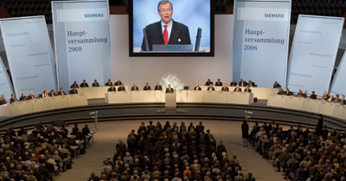
Shareholders
Siemens 2008 Shareholders Meeting

Slide 24
The Role of Shareholders #1…
…to elect directors and to remove them

Slide 25
The Role of Shareholders #2…
There are certain powers expressly reserved to shareholders by statute, e.g., amendments to the constitution, other “fundamental” changes such as approving sale of undertaking. BCBCA section 259; CBCA section 173 are some examples…

Slide 26
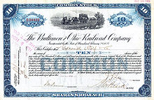
What/who is a shareholder?
BCBCA: “shareholder”…means a person whose name is entered in a securities register of a company as a registered owner of a share of the company…”
No comparable provision in CBCA.

Slide 27
Statutory v. Contractual models
CBCA corporate model = Residual power to manage the corporation’s affairs rests with the directors.
This power is given by statute and is not derived from the delegation of powers by the shareholders (through by-laws).
To be contrasted with the British model of corporate law under which the directors enjoy only those powers delegated to them by the shareholders (contractual).

Slide 28
Northern Minerals Investment Corp. v. Mundoro Capital Inc. 2012 BCSC 1090
A key was that there no evidence that the board was not acting in the best interests of the shareholder: “The actions of the board in this instance in creating an advance notice policy have not been shown to having been done to “influence or preclude” a proxy contest but rather to insure that all shareholders are made aware that a proxy contest exists. No evidence has been put forward that the directors are not behaving reasonably.”

Slide 29
Punnett J. found the articles and Act, and the residual “basket clause” in the articles and the Act are to be read as was done the case in Canadian Jorex Ltd. v. 477749 Alberta Ltd. and the case of Oppenheimer & Co. v. United Grain Growers Ltd. (1997) 2 W.W.R. 9 (Q.B.). It was held that as a matter of contractual interpretation the directors’ powers flow from the Act and articles in which the directors are in fact granted residual powers. In this way the court treated the BC and CBCA models as substantially similar. Both are accordingly, essentially, board-centric.

Slide 30

Next Topic: LIMITATIONS OF BOARD-CENTRIC MODEL AND RE-DESIGNING THE ARCHITECTURE

Slide 31

Example of a close corp.

Slide 32
Publicly Held Corporations
The theoretical model: Power flows from the shareholders, who decide who will be directors, to directors, who choose officers and set policies, to the officers who implement the policies.
The reality: In practice, the officers, particularly the chief executive officer (CEO), commonly decide who will be the directors and what policies the corporation will pursue.

Slide 33
Why do the theoretical model and the reality diverge? Four possible reasons:
Shareholders in publicly held corporations are typically “rationally apathetic”.
Logistical and other costs of changing management is high. Rewards to changing management often are low. Usually just cheaper and easier to just sell your shares.
Incumbent shareholders, directors and officers effectively control the “voting machinery”.
Superstar CEO’s are a counterweight to the theoretical model where the locus of the power of appointment is intended to be in the shareholders.

Slide 34
Re-read BCBCA Section 137 (1)
Powers of directors may be transferred
137 (1) …the articles of a company may transfer, in whole or in part, the powers of the directors to manage or supervise the management of the business and affairs of the company to one or more other persons.

Slide 35
Effect…
“(2) If the whole or any part of the powers of the directors is transferred in the manner contemplated by subsection (1),
  (a) the persons to whom those powers are transferred have all the rights, powers, duties and liabilities of the directors of the company, whether arising under this Act or otherwise, in relation to and to the extent of the transfer, including any defences available to the directors, and
  (b) the directors are relieved of their rights, powers, duties and liabilities to the same extent.”

Slide 36
CBCA: Restricting Directors
Under the CBCA there is no requirement that “the articles of a company may transfer…” as under section 137 (1) of the BCBCA. Rather, the CBCA allows for a “lawful written agreement among all the shareholders”.
“146.(1) An otherwise lawful written agreement among all the shareholders of a corporation, or among all the shareholders and one or more persons who are not shareholders, that restricts, in whole or in part, the powers of the directors to manage, or supervise the management of, the business and affairs of the corporation is valid.
(2) If a person who is the beneficial owner of all the issued shares of a corporation makes a written declaration that restricts in whole or in part the powers of the directors to manage, or supervise the management of, the business and affairs of the corporation, the declaration is deemed to be a unanimous shareholder agreement…

Slide 37
…(5) To the extent that a unanimous shareholder agreement restricts the powers of the directors to manage, or supervise the management of, the business and affairs of the corporation, parties to the unanimous shareholder agreement who are given that power to manage or supervise the management of the business and affairs of the corporation have all the rights, powers, duties and liabilities of a director of the corporation, whether they arise under this Act or otherwise, including any defences available to the directors, and the directors are relieved of their rights, powers, duties and liabilities, including their liabilities under section 119, to the same extent.
(6) Nothing in this section prevents shareholders from fettering their discretion when exercising the powers of directors under a unanimous shareholder agreement.”

Slide 38
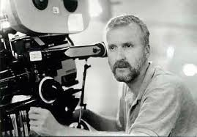
Now: Directors in depth
James Cameron

Slide 39
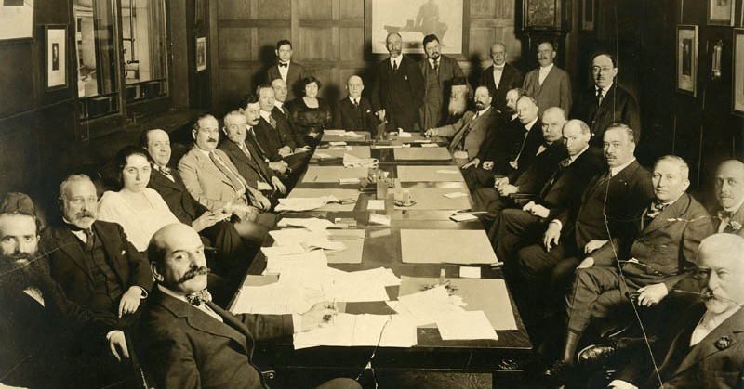
Yes a Company must have Directors
BCBCA s. 120; CBCA 102 (2)
Public companies (publicly distributed or traded) have to have at least 3 directors; others only1.

Slide 40
What is a Director?
CBCA section 2 (1): “a person occupying the position of director by whatever name called”.
BCBCA Section 1 (1): “an individual who is a member of the board of directors of the company as a result of having been elected or appointed to that position”.

Slide 41
Categories or Kinds of Directors
(a) De jure director
A “de jure” director is one who has been elected or appointed by a proper procedure. In comparison consider those performing the functions of directors per BCBCA s. 138(1).
In Chell v. The Queen, 2013 TCC 29 the following definition was provided by the court:
“A de jure director is an individual who has been appointed as such pursuant to the corporate law of the jurisdiction in which the corporation was created or continued, as the case may be.”

Slide 42
BCBCA s. 138 (1) provides…
“138. (1) Without limiting section 137 but subject to subsection (2) of this section, if a person who is not a director of a company performs functions of a director of the company, sections 142, 231, 234, 251, 335, 347 and 354 and Divisions 3 to 5 of this Part apply to that person
(a) as if that person were a director of the company, and
(b) in relation to, and only to the extent of, those functions.”

Slide 43
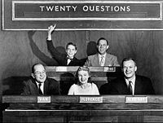
Q. Why are other definitions relevant and how did they originate?
A. FOR Director’s Liability purposes

Slide 44
De facto director
A de facto director is one who has not been legally appointed but acts as if they have been or assumes the position. A de facto director openly acts as though validly appointed despite a lack of authority and right to act. A director whose appointment is irregular falls into this category; also a person who is not appointed at all but is held out as a director.

Slide 45
Shadow directors
In British Columbia Securities Commission v. Alexander, 2013 BCCA 111 per Madam Justice D. Smith:
“The legal test for a finding that an individual acted as a de facto director or officer is “’whether, under the particular circumstances, the alleged director is an integral part of the mind and management of the company, taking into account the entirety of the alleged director’s involvement within the context of the business activities at issue…”.
A shadow director is different from “de facto directors” because they do not purport to act as directors. They claim not to be directors and so seek to hide behind those who are. In that sense, they “lurk in the shadows”. They are persons “in accordance with whose directions or instructions the directors of the company are accustomed to act”.

Slide 46
Nominee directors
Someone who represents the interests of a “stakeholder”.
Discussion of the duties of a nominee director, see Deluce Holdings Inc. v. Air Canada, 98 D.L.R. (4th) 509 (1992).
Court found that Air Canada’s nominees were carrying out Air Canada’s agenda. As a result the law became reasonably clear. A nominee director must always put the best interest of the company they are a director of first, ahead of the company that may have nominated them. Notwithstanding this constraint, the practice of placing nominee directors on boards will not be going away any time soon.

Slide 47
Alternate directors
Standard form BC articles :
“15.1 Appointment of Alternate Director
Any director (an “appointor”) may by notice in writing received by the Company appoint any person (an “appointee”) who is qualified to act as a director to be his or her alternate to act in his or her place at meetings of the directors or committees of the directors at which the appointor is not present unless (in the case of an appointee who is not a director) the directors have reasonably disapproved the appointment of such person as an alternate director and have given notice to that effect to his or her appointor within a reasonable time after the notice of appointment is received by the Company.”

Slide 48
Qualifications & Disqualifications of Directors
In general there are few prescribed qualifications to be a director. It is felt that the shareholders are best equipped to decide who ought to be a director.
Got to be a real flesh & blood human though:
BCBCA 124 (1): “an individual who is qualified” to act.
CBCA 105. (1): “person who is not an individual” is disqualified.

Slide 49
Qualifications - residency
CBCA section 105 (3) requires that at least 25% of a company’s directors must be “resident Canadians” (defined in section 2 (1)) though in certain prescribed businesses a majority of resident Canadians is required.
There used to be similar requirement in the BCBCA, but no longer.
Note that under CBCA s. 114, subject to certain exceptions, directors may not transact business unless at least 25% or a majority of the directors present satisfy the residency requirement.
What is the justification for residency requirements?

Slide 50
Qualifications - competence
Corporate legislation is generally silent on experience or competence that must be satisfied as a condition of eligibility to become a director.
Why would this be (especially given the many corporate scandals witnessed over the years)?
The notion of competence must obviously be somehow connected to the statutory duty of care and skill…doesn’t it?
When it comes to publicly traded corporations the stock exchanges are interested that corporate management, including board of directors, have adequate experience and technical expertise relevant to the company’s business and industry as well as public company experience.
Training is available through the Institute of Directors. See http://www.iod.com for more information.

Slide 51
BCBCA Section 142 provides…
“142. (1) A director or officer of a company, when exercising the powers and performing the functions of a director or officer of the company, as the case may be, must…
(b) exercise the care, diligence and skill that a reasonably prudent individual would exercise in comparable circumstances,…”
Note that the CBCA 122 is nearly identical in its wording:
“122. (1) Every director and officer of a corporation in exercising their powers and discharging their duties shall…
(b) exercise the care, diligence and skill that a reasonably prudent person would exercise in comparable circumstances.”

Slide 52

Institute of Directors
https://www.iod.com/

Slide 53
Qualifications - Independence
For publicly traded companies, directors are to be selected by a nominating committee composed of non-management directors. In 1994, the TSE published “Where Were the Directors?” (also known as the “Dey Report”) containing 14 recommendations relating to corporate governance, including:
“Guideline 4: The board of directors…should appoint a committee of directors composed exclusively of outside, i.e., non-management, directors, a majority of whom are unrelated directors, with the responsibility for proposing to the full board new nominees to the board and for assessing directors on an ongoing basis.
Guideline 5: Every board of directors should implement a process to be carried out by the nominating committee or other appropriate committee, for assessing the effectiveness of the board as a whole, the committees of the board and the contribution of individual directors.
Guideline 6: Every corporation, as an integral element of the process for appointing new directors, should provide an orientation and education program for new recruits to the board.”

Slide 54
Disqualifications
BCBCA section 124 (2) and CBCA section 105 (1) set out who are those persons disqualified to act as a director. BCBCA 124 (2)(d) which disqualifies a person..“convicted in or out of British Columbia of an offence in connection with the promotion, formation or management of a corporation or unincorporated business, or of an offence involving fraud, unless…” Note there is nothing comparable in CBCA.
The BC Securities Act [RSBC 1996] provides:
“161. (1) If the commission or the executive director considers it to be in the public interest, the commission or the executive director, after a hearing, may order one or more of the following:…
(d) that a person
(i) resign any position that the person holds as a director or officer of an issuer or registrant,
(ii) is prohibited from becoming or acting as a director or officer of any issuer or registrant,
(iii) is prohibited from becoming or acting as a registrant or promoter,
(iv) is prohibited from acting in a management or consultative capacity in connection with activities in the securities market,…”

Slide 55
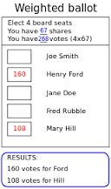

Next class:
Election of Directors
The (Fiduciary) Obligations Of Corporate Management

Slide 56

I have “separate” corporate cat-hood.

