Slide 1


The (Fiduciary) Obligations of Corporate Management #1
Talk 20
LAW 459 003
BUSINESS ORGANIZATIONS
Allard School of Law, UBC
Fall, 2016
Jon Festinger Q.C.
Festinger Law & Strategy
http://bizorg.allard.ubc.ca
@jonfestinger
jon@fblawstrategy.com

Slide 2
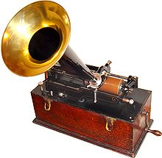
Happy November 21
LAW 459 003
BUSINESS ORGANIZATIONS
139 years ago today Thomas Edison announced his invention of the phonograph, a machine that can record and play sound.

Slide 3
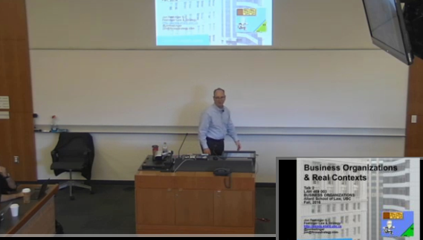
Lecture Capture Monday

Slide 4
1st:Office Hours today until 4 P.M., Room 341

Slide 5
2nd: Reminder
Second assignment due Monday November 28, 2016 by 9 AM (or at beginning of class)

Slide 6
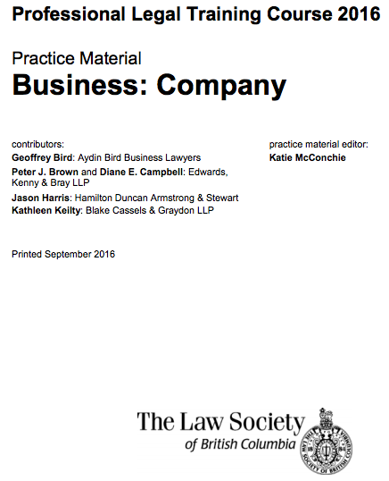
3rd: Useful Resource (reminder)
https://www.lawsociety.bc.ca/docsbecoming/material/Company.pdf

Slide 7
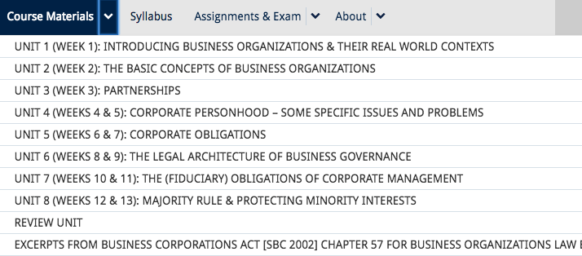
4th: Exam Preparation

Slide 8

Extra Exam Preparation Class
Tuesday November 29, 2016 12:30 – 2 PM
Room 106

Slide 9

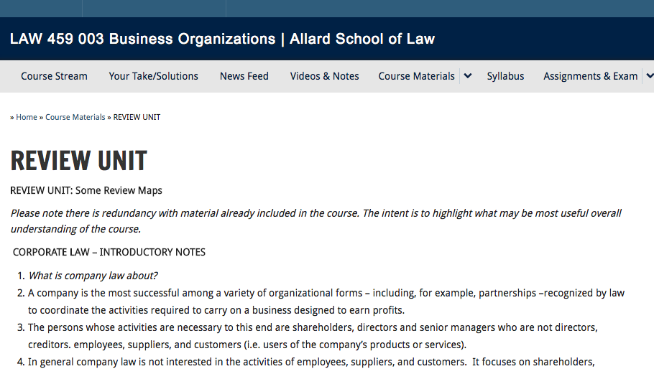

Slide 10
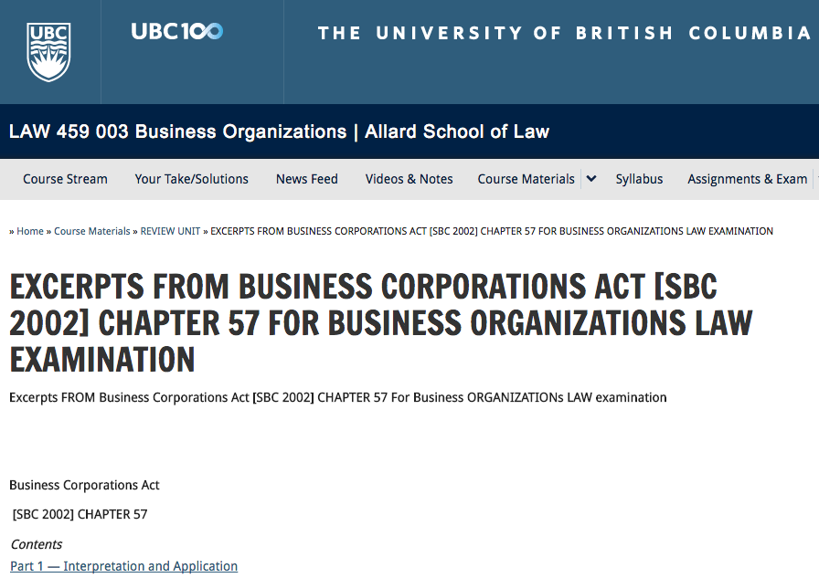
AFRAID YOU HAVE TO BRING YOUR OWN STATUTES

Slide 11

4th: News of the Week
Think of McCormick v. Fasken Martineau
DuMoulin LLP, 2014 SCC 39

Slide 12
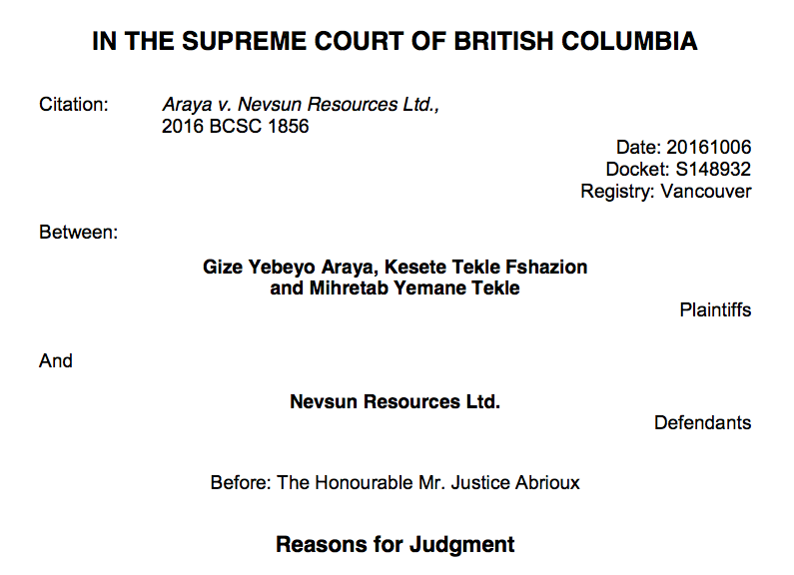
Follow-Up: Nevsun (forced labour)

Slide 13
One of the issues is “the potential corporate liability for alleged breaches of both private and customary international law. This in turn raises issues of corporate immunity and whether the act of state doctrine raises a complete defence to the plaintiffs’ claims.”
Mostly an international law (forum) & class action case at this stage
“The Bisha Mining Share Company (“BMSC”) owns and operates the Bisha Mine. Nevsun exercises effective control over BMSC. It controls a majority of the Board of BMSC and Cliff Davis, the CEO of Nevsun, is the Chair of BMSC.”

Slide 14
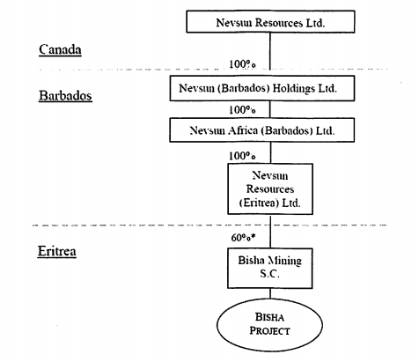

Slide 15
Claim of Direct Liability of Nevsum
Claim “Nevsun Is liable for the conduct of BMSC on the grounds that:
    BMSC was at all times acting as the agent of Nevsun;
    BMSC is an extension of the business enterprise of Nevsun, and Nevsun is therefore vicariously liable for BMSC's conduct; and
    the corporate ownership structure separating Nevsun from BMSC Is artificial and should be disregarded In the Interests of justice.”
Claim that “Nevsun is vicariously liable for the conduct of Segen, Mereb and the Eritrean military at the Bisha Mine in furtherance of Nevsun’s commercial objectives;”

Slide 16

Follow-up #2:
Shareholder Directors in Germany
Structure in Germany for large companies (where employees participate on the “Board” is two tiered.
A second tier supervisory board that elects the first tier “executive directors”.
Employees sit on the 2nd tier board and appear to have no different duties then anyone else (primarily duties of loyalty and competence).

Slide 17
QUESTIONS? DISCUSSION?

Slide 18

Now Back to Our Regularly Scheduled Programming…

Slide 19
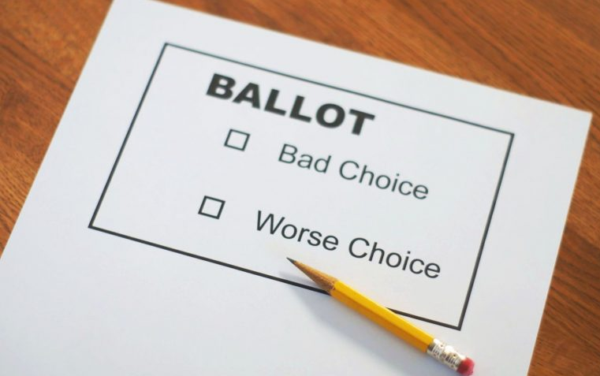
Completing….Unit 6:
The Legal Architecture of Business Governance

Slide 20
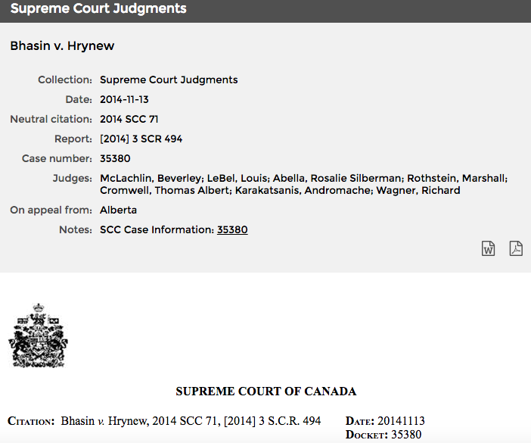
Applicability of the duty of good faith in commercial contracts

Slide 21

Legal
Framework

Slide 22
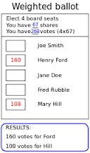
Now: Election of Directors

Slide 23
Are they?…
“Corporations are democratic institutions” (Welling @page 98 of the casebook). Discuss.

Slide 24

On Birthing Directors…
BCBCA section 122 (1): “Directors…must be elected or appointed in accordance with this Act and with the memorandum and articles of the company.”

Slide 25

The End
BCBCA section 128 (1):
A director ceases to hold office when
  (a) the term of office of that director expires in accordance with
    (i) this Act or the memorandum or articles, or
    (ii) the terms of his or her election or appointment,
  (b) the director dies or resigns, or
  (c) the director is removed in accordance with subsection (3) or (4).”

Slide 26
BCBCA 128 (3) allows for the removal of directors by special resolution, or as specified in the memorandum or articles of the company…
BCBCA 128 (4) provides comparable provisions for classes of shareholders holding shares of a class or series of shares of a company removing those directors whom they have the exclusive right to elect or appoint. These would be resolutions of a specific class of shareholders depending on the specific type of shares they own (as opposed to all of the shareholders).
See also CBCA sections 109 and 110.

Slide 27
Terms
BCBCA
Permits terms of more than one year (no maximum)
Minimalist – very few restrictions (N.B. growth of Board formula)
CBCA
Maximum 3 years per term
No maximum terms
Staggered terms permitted
Note 1: TSX requires each Director to be elected annually
Note 2: Restrictions would be in Memorandum & By-Laws etc.

Slide 28
Voting
Private companies: Usually straightforward, rarely an issue.
Publicly traded companies: plurality or slate voting was common until recently. TSX prohibits slate voting.
Slate voting: Shareholders may vote for all of the directors nominated by management (i.e. a slate of directors), but not for individual directors. The only option in such cases is to vote against the whole board, or conduct a costly proxy fight

Slide 29
Plurality Voting: You vote for or withhold vote. Yea or Nay.
So directors can be elected without receiving a majority (I.E. not over 50%) of shareholder votes.
Per TSX, any director nominee receiving a greater number of votes ‘withheld’ from than ‘for’ their election, would be required to tender their resignation. Remaining board members would generally accept such resignation.

Slide 30
Cumulative voting
Generally a shareholder only has one vote per share and may not give more than the one vote per share to any single nominee. E.G. If there are 4 board seats & you hold 500 shares (with 1 vote per share), under the regular method you could vote a maximum of 500 shares for any one candidate.
“Cumulative Voting” allows a shareholder to cast all of their votes for a single nominee. Accordingly you could choose to vote all of your (cumulative) 2,000 votes (500 shares x 4 board positions) for one candidate, or 1,000 each to two candidates, or otherwise divide your votes whichever way you want.
Intended to allow minority shareholders to elect some directors in rough proportion to voting strength.

Slide 31
CBCA Section 107 provides…
“Cumulative voting
Where the articles provide for cumulative voting,
(a) the articles shall require a fixed number and not a minimum and maximum number of directors;
(b) each shareholder entitled to vote at an election of directors has the right to cast a number of votes equal to the number of votes attached to the shares held by the shareholder multiplied by the number of directors to be elected, and may cast all of those votes in favour of one candidate or distribute them among the candidates in any manner;…”

Slide 32
Calling and Convening Meetings
Canadian Jorex Ltd. v. 477749 Alberta Ltd.
Northern Minerals Investment Corp. v. Mundoro Capital Inc. already discussed…
The “company” must send notice of date, time and location. [Who is the company for this purpose?]
There are other opportunities for shareholders. For example meetings can be requisitioned pursuant to BCBCA section 167 (CBCA section 143). Shareholders holding at least 5% of the issued voting shares may requisition a meeting for the purpose of transacting any business that may be transacted at a general meeting.

Slide 33
There are exceptions:
(a) if they have called a general meeting to be held after date of requisition and have given notice thereof;
(b) if substantially the same business was submitted to shareholders at a meeting held not more than 5 years ago and received less than 3% of the vote if it was tried once, less than 6% of the vote of it was tried twice, and less than 10% of the vote if tried 3 times.
(c) the business stated in the requisition does not relate in a significant way to the business or affairs of the company,
(d) it clearly appears that the primary purpose for the requisition is (i) securing publicity, or (ii) enforcing a personal claim or redressing a personal grievance against the company or any of its directors, officers or security holders,
(e) the business stated in the requisition has already been substantially implemented.
Otherwise the directors must call a meeting (to be held within 4 months) within 21 days after receipt of requisition and if they do not the requisitioning shareholders, or any one or more of them holding, in the aggregate, more than 1/40 of the issued shares of the company that carry the right to vote at general meetings, may do so.

Slide 34
BCBCA section 167: Important
(1) Shareholders referred to in subsection (2) may requisition a general meeting for the purpose of transacting any business that may be transacted at a general meeting.
(2) A requisition under this section may be made by shareholders who, at the date on which the requisition is received by the company, hold in the aggregate at least 1/20 of the issued shares of the company that carry the right to vote at general meetings.
(3) A requisition under this section
(a) must, in 1 000 words or less, state the business to be transacted at the meeting, including any special resolution or exceptional resolution to be submitted to the meeting,
(b) must be signed by, and include the names and mailing addresses of, all of the requisitioning shareholders,
(c) may be made in a single record or may consist of several records, in similar form and content, each of which is signed by one or more of the requisitioning shareholders, and
(d) must be delivered to the delivery address of, or mailed by registered mail to the mailing address of, the registered office of the company.

Slide 35
(4) If a requisition under this section consists of more than one record, the requisition is received by the company on the first date by which the company has received requisition records that comply with subsection (3) from shareholders who, in the aggregate, hold at least the number of shares necessary to qualify under subsection (2).
(5) On receiving a requisition that complies with subsections (2) and (3), the directors must, regardless of the memorandum or articles, call a general meeting to be held not more than 4 months after the date on which the requisition is received by the company to transact the business stated in the requisition and must, subject to subsection (7),
(a) send notice of the date, time and location of that meeting at least the prescribed number of days, but not more than 4 months, before the meeting
(i) to each shareholder entitled to attend the meeting, and
(ii) to each director, and
(b) send, in accordance with subsection (6), to the persons entitled to notice of the meeting, the text of the requisition referred to in subsection (3) (a).
(6) The text referred to in subsection (5) (b) must be sent
(a) in, or within the time set for the sending of, the notice of the requisitioned meeting, or
(b) in the company’s information circular or equivalent, if any, sent in respect of the requisitioned meeting.

Slide 36
(7) The directors need not comply with subsection (5) if
(a) the directors have called a general meeting to be held after the date on which the requisition is received by the company and have sent notice of that meeting in accordance with section 169,
(b) substantially the same business was submitted to shareholders to be transacted at a general meeting that was held not more than the prescribed period before the receipt of the requisition, and any resolution to transact that business at that earlier meeting did not receive the prescribed amount of support,
(c) it clearly appears that the business stated in the requisition does not relate in a significant way to the business or affairs of the company,
(d) it clearly appears that the primary purpose for the requisition is
(i) securing publicity, or
(ii) enforcing a personal claim or redressing a personal grievance against the company or any of its directors, officers or security holders,
(e) the business stated in the requisition has already been substantially implemented,
(f) the business stated in the requisition, if implemented, would cause the company to commit an offence, or
(g) the requisition deals with matters beyond the company’s power to implement.

Slide 37
(8) If the directors do not, within 21 days after the date on which the requisition is received by the company, send notice of a general meeting in accordance with subsection (5) of this section, the requisitioning shareholders, or any one or more of them holding, in the aggregate, more than 1/40 of the issued shares of the company that carry the right to vote at general meetings, may send notice of a general meeting to be held to transact the business stated in the requisition.
(9) A general meeting called, under subsection (8), by the requisitioning shareholders must
(a) be called in accordance with subsection (5),
(b) be held within 4 months after the date on which the requisition is received by the company, and
(c) as nearly as possible, be conducted in the same manner as a general meeting called by the directors.
(10) Unless the shareholders resolve otherwise by an ordinary resolution at the general meeting called, under subsection (8), by the requisitioning shareholders, the company must reimburse the requisitioning shareholders for the expenses actually and reasonably incurred by them in requisitioning, calling and holding that meeting.”

Slide 38
Shareholder Proposals: BCBCA sections 187-191 & CBCA section 137
A qualified shareholder may send the company a notice setting out a matter that they wish to have considered at the next AGM. A “qualified shareholder” is generally one who holds a voting share and has held it for at least two years.
To be valid, a proposal must be supported by qualified shareholders (i.e. those meeting the same 2 year test) holding at least 1% of the issued voting shares or shares with a “fair market value” of at least $2000.
If a proposal is received the company must send it, and any explanatory statement as part of the Annual General Meeting materials and must allow the shareholder to present it at the meeting.
The obligation to send proposal to shareholders is not applicable if the Annual General Meeting has already been called; if substantially the same proposal was submitted within the preceding two years and did not achieve the support thresholds applicable in relation to requisitions; or if one of the other requisition exclusions applies.

Slide 39
Quorum and Enhanced Quorum By-Laws
What is quorum for a shareholders meeting? The normal quorum requirements are set out in BCBCA section 172.
Quorum for a shareholders meeting will be established by having the number of shareholders present established by the Memorandum and Articles of the company or, if no quorum is set out, then two shareholders present in person or by proxy regardless of number of shares represented will establish quorum for a shareholders meeting.
Paragraph 11.3 of the standard form BC articles establishes quorum if there are present at the shareholders meeting two persons who are, or who represent by proxy, shareholders who, in the aggregate, hold at least 5% of the issued shares entitled to be voted at the meeting. The same mechanic is provided in paragraph 8.5 of the standard form of Federal Bylaws.
An “Enhanced Quorum” is where the articles or bylaws of a company require that a minimum of two shareholders holding at least a majority of the issued and outstanding common shares are required to be present or represented by proxy at any meeting at which a shareholder will be seeking to replace half or more of the board of directors, before the meeting can be held and business validly transacted.

Slide 40


Executive Compensation
“Say on pay” is not mandatory in Canada.
Top compensation in public companies is public.

Slide 41
QUESTIONS? DISCUSSION?

Slide 42

Next Topic:
The (Fiduciary) Obligations Of Corporate Management

Slide 43

Starting Point

Slide 44

2 Duties of Directors in
Duty of care of directors and officers
122 (1) Every director and officer of a corporation in exercising their powers and discharging their duties shall
  (a) act honestly and in good faith with a view to the best interests of the corporation; and
  (b) exercise the care, diligence and skill that a reasonably prudent person would exercise in comparable circumstances.
= The Fiduciary Duty
= The Duty of Care

Slide 45
A Subjective or Objective Test?
BCBCA section 142(1): “A director or officer of a company, when exercising the powers and performing the functions of a director or officer of the company, as the case may be, must . . . (b) exercise the care, diligence and skill that a reasonably prudent individual would exercise in comparable circumstances.”
CBCA section 122(1): “Every director and officer of a corporation in exercising their powers and discharging their duties shall . . . (b) exercise the care, diligence and skill that a reasonably prudent person would exercise in comparable circumstances.”

Slide 46

And to whom is care diligence and skill owed?

Slide 47
To who are fiduciary duties owed ?

Slide 48
Peoples Department Stores Inc. v. Wise [2004] 3 SCR 461
“That directors must satisfy a duty of care is a long-standing principle of the common law, although the duty of care has been reinforced by statute to become more demanding. Among the earliest English cases establishing the duty of care were Dovey v. Cory, [1901] A.C. 477 (H.L.); In re Brazilian Rubber Plantations and Estates, Ltd., [1911] 1 Ch. 425; and In re City Equitable Fire Insurance Co., [1925] 1 Ch. 407 (C.A.). In substance, these cases held that the standard of care was a reasonably relaxed, subjective standard. The common law required directors to avoid being grossly negligent with respect to the affairs of the corporation and judged them according to their own personal skills, knowledge, abilities and capacities. See McGuinness, supra, at p. 776: “Given the history of the case law in this area, and the prevailing standards of competence displayed in commerce generally, it is quite clear that directors were not expected at common law to have any particular business skill or judgment.”

Slide 49
“in comparable circumstances”
“The words “in comparable circumstances”, modify the statutory standard by requiring the context in which a given decision was made to be taken into account. This is not the introduction of a subjective element relating to the competence of the director, but rather the introduction of a contextual element into the statutory standard of care. It is clear that s. 122(1)(b) requires more of directors and officers than the traditional common law duty of care outlined in, for example, Re City Equitable Fire Insurance, supra.
The standard of care embodied in s. 122(1)(b) of the CBCA is . . . an objective standard. The factual aspects of the circumstances surrounding the actions of the director or officer are important . . . as opposed to the subjective motivation of the director or officer.”

Slide 50
Soper v. Canada [1998] 1 F.C. 124 (C.A.)
“The second proposition that I wish to discuss is the following: a director need not exhibit in the performance of his or her duties a greater degree of skill and care than may reasonably be expected from a person of his or her knowledge and experience…
Third, a director is not obliged to give continuous attention to the affairs of the company, nor is he or she even bound to attend all meetings of the board. However when, in the circumstances, it is reasonably possible to attend such meetings, a director ought to do so. Subsequent English cases, though, went to more of an extreme, permitting a director to avoid liability despite having missed all board meetings for a period of several years…

Slide 51
Fourth, in the absence of grounds for suspicion, it is not improper for a director to rely on company officials to perform honestly duties that have been properly delegated to them. Further to this point, it is the exigencies of business and the company’s articles of association that, together, will determine whether it is appropriate to delegate a duty. The larger the business, for instance, the greater will be the need to delegate…
Hence, in the event that the reasonably prudent person is unskilled (which possibility is discussed above), the statute requires only the exercise of a degree of care which is commensurate with that person’s level of skill. It is in this manner that skill and care are clearly interconnected. That being said, it is worth emphasizing that it is insufficient for a director to assert simply that he or she did his or her best if, having regard to that individual’s level of skill and business experience, he or she failed to act reasonably prudently.”

Slide 52
BCE v. 1976 Debentureholders [2008] 3 SCR 560
“A second remedy lies against the directors in a civil action for breach of duty of care. As noted, s. 122(1) (b) of the CBCA requires directors and officers of a corporation to “exercise the care, diligence and skill that a reasonably prudent person would exercise in comparable circumstances”. This duty, unlike the s. 122(1) (a) fiduciary duty, is not owed solely to the corporation, and thus may be the basis for liability to other stakeholders in accordance with principles governing the law of tort and extra-contractual liability: Peoples Department Stores. Section 122(1) (b) does not provide an independent foundation for claims. However, applying the principles of The Queen in right of Canada v. Saskatchewan Wheat Pool, [1983] 1 S.C.R. 205, courts may take this statutory provision into account as to the standard of behavior that should reasonably be expected.”

Slide 53
&…
Business Judgment Rule is a “Defense”
[Curial deference to business driven decision making]

Slide 54
CBCA 123(5)
Defence — good faith
123 (5) A director has complied with his or her duties under subsection 122(1) if the director relied in good faith on
  (a) financial statements of the corporation represented to the director by an officer of the corporation or in a written report of the auditor of the corporation fairly to reflect the financial condition of the corporation; or
  (b) a report of a person whose profession lends credibility to a statement made by the professional person.

Slide 55
Who is a “person whose profession lends credibility”?
SCC in “Wise”: “When faced with the serious inventory management problem, the Wise brothers sought the advice of the vice-president of finance, David Clément…Although Clément did have a bachelor’s degree in commerce and 15 years of experience in administration and finance with Wise, this experience does not correspond to the level of professionalism required to allow the directors to rely on his advice as a bar to a suit under the duty of care. The named professional groups in s. 123(4) (b) were lawyers, accountants, engineers, and appraisers. Clément was not an accountant, was not subject to the regulatory overview of any professional organization and did not carry independent insurance coverage for professional negligence. The title of vice-president of finance should not automatically lead to a conclusion that Clément was a person “whose profession lends credibility to a statement made by him”.

Slide 56
BCBCA Section 157
“157. (1) A director of a company is not liable under section 154 and has complied with his or her duties under section 142 (1) if the director relied, in good faith, on
(a) financial statements of the company represented to the director by an officer of the company or in a written report of the auditor of the company to fairly reflect the financial position of the company,
(b) a written report of a lawyer, accountant, engineer, appraiser or other person whose profession lends credibility to a statement made by that person,
(c) a statement of fact represented to the director by an officer of the company to be correct, or
(d) any record, information or representation that the court considers provides reasonable grounds for the actions of the director, whether or not
(i) the record was forged, fraudulently made or inaccurate, or
(ii) the information or representation was fraudulently made or inaccurate.

Slide 57
QUESTIONS? DISCUSSION?

Slide 58

Insider Trading

Slide 59
Securities Act [RSBC 1996] Chapter 418
“57.2 (1) In this section, “issuer” means
(a) a reporting issuer, or (b) any other issuer whose securities are publicly traded.
(2) A person must not enter into a transaction involving a security of an issuer, or a related financial instrument of a security of an issuer, if the person
(a) is in a special relationship with the issuer, and
(b) knows of a material fact or material change with respect to the issuer, which material fact or material change has not been generally disclosed.
(3) An issuer or a person in a special relationship with an issuer must not inform another person of a material fact or material change with respect to the issuer unless
(a) the material fact or material change has been generally disclosed, or
(b) informing the person is necessary in the course of business of the issuer or of the person in the special relationship with the issuer…

Slide 60
Due diligence defence for insider trading
136.2 A person is not liable under section 136 or 136.1 (1) if, after a reasonable investigation occurring before the person
(a) entered into the transaction,
(b) informed another person of the material fact or material change, or
(c) recommended or encouraged a transaction,
the person had no reasonable grounds to believe that the material fact or material change had not been generally disclosed.

Slide 61
Coming Soon
MANAGERS’ FIDUCIARY OBLIGATIONS
CONFLICTS OF INTEREST AND DUTY
CORPORATE OPPORTUNITIES DOCTRINE
TAKE-OVER BIDS

Slide 62

I have “separate” corporate cat-hood.

