Slide 1


The (Fiduciary) Obligations of Corporate Management #3
Talk 22
LAW 459 003
BUSINESS ORGANIZATIONS
Allard School of Law, UBC
Fall, 2016
Jon Festinger Q.C.
Festinger Law & Strategy
http://bizorg.allard.ubc.ca
@jonfestinger
jon@fblawstrategy.com

Slide 2
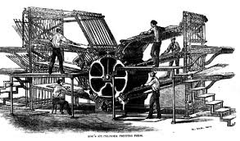
Happy November 28
LAW 459 003
BUSINESS ORGANIZATIONS
202 years ago today The Times of London first printed by automatic, steam powered presses making newspapers available to a mass audience

Slide 3
Evaluations
Online at
https://eval.ctlt.ubc.ca/law until Monday December 5 @ 11:59 PM

Slide 4
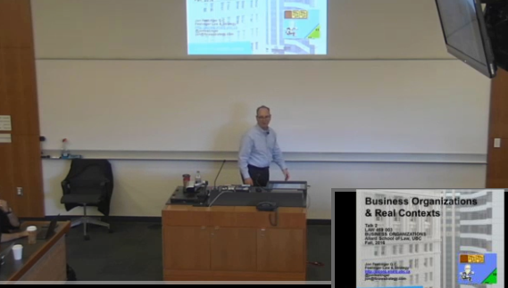
Lecture Capture Monday

Slide 5
3rd: Reminder
Second assignment due TODAY, (by 9 AM or at beginning of class)

Slide 6

4th: Extra Exam Preparation Class
Tuesday November 29, 2016 12:30 – 2 PM
Room 106
No lecture
capture
available

Slide 7

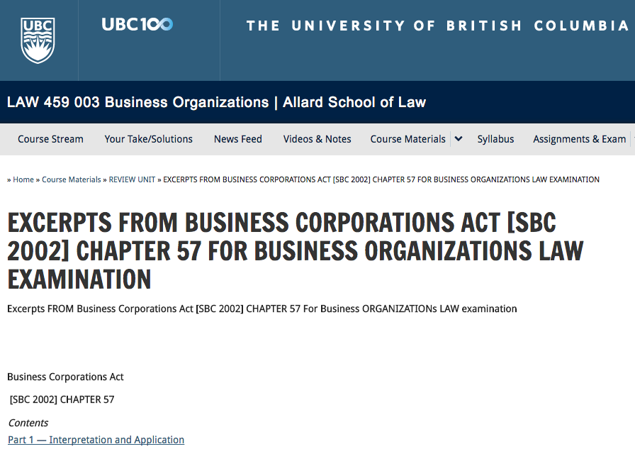
AFRAID YOU HAVE TO BRING YOUR OWN STATUTES

Slide 8
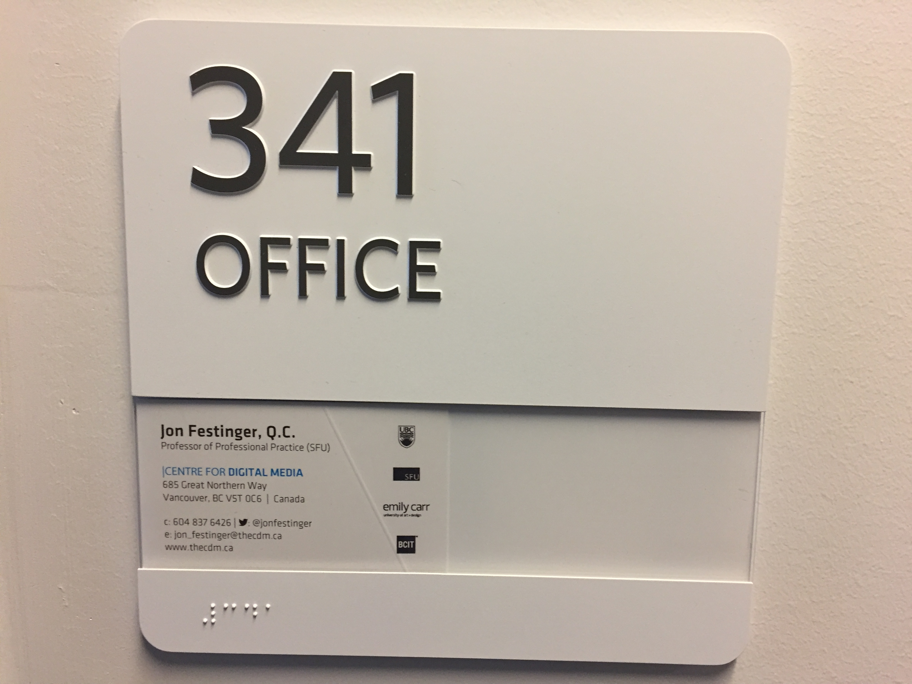
5th: Office Hours Today
Until 2 PM or until everyone is done or by appointment

Slide 9
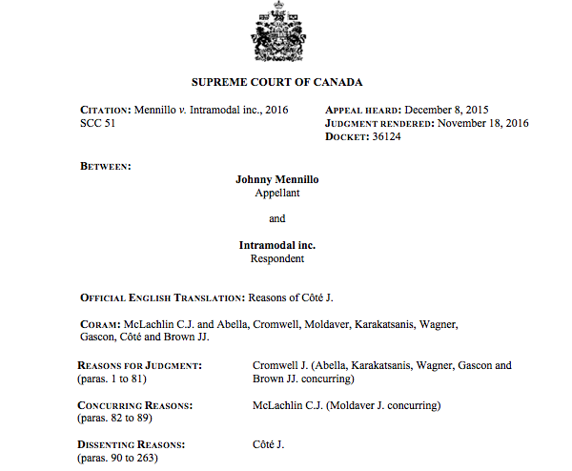
6th: News of the Week

Slide 10
QUESTIONS? DISCUSSION?

Slide 11

Now Back to Our Regularly Scheduled Programming…

Slide 12
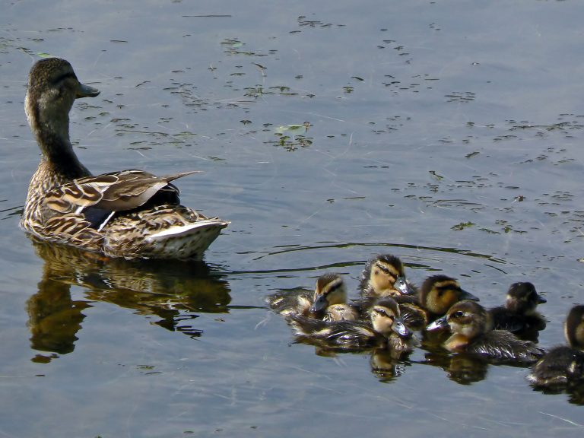
Continuing….Unit 7:
The (Fiduciary) Obligations of Corporate Management

Slide 13

2 Duties of Directors in
Duty of care of directors and officers
122 (1) Every director and officer of a corporation in exercising their powers and discharging their duties shall
  (a) act honestly and in good faith with a view to the best interests of the corporation; and
  (b) exercise the care, diligence and skill that a reasonably prudent person would exercise in comparable circumstances.
= The Fiduciary Duty
= The Duty of Care

Slide 14

And to whom is care diligence and skill owed?
BCE v. 1976 Debentureholders [2008] 3 SCR 560

Slide 15
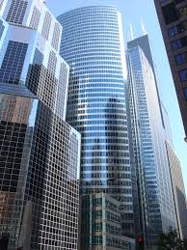
To whom are fiduciary duties owed ?

Slide 16
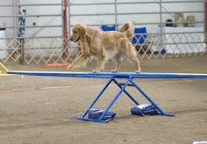
Objective v. Subjective Standards
Per Peoples Department Stores Inc. v. Wise [2004] 3 SCR 461 the “Duty of Care” in s. 122(1)(b) of the CBCA should be an “objective” standard.
Going forward, ask yourself whether the “Fiduciary Duty” in s. 122(1)(a) of the CBCA is objective or subjective???

Slide 17

Hint…
Note the tendency towards strict enforcement of (relatively) strict rules with respect to fiduciary obligations (as opposed to “duty of care” ones). Are strict standards objective or are they a substitute for objectivity?
Ducks in a row

Slide 18
MANAGERS’ FIDUCIARY OBLIGATIONS

Slide 19

Historical Context
Trust entities were one of the antecedent form analogous to what we recognize as companies today (particularly in 19th century UK)
Trust = Holding title of property for another
Notion of “fiduciary relationship” flows from trust law
Est. 1868

Slide 20
Peoples Department Stores v. Wise
“The first duty has been referred to in this case as the “fiduciary duty”. It is better described as the “duty of loyalty”.
“The statutory fiduciary duty requires directors and officers to act honestly and in good faith vis-à-vis the corporation. They must respect the trust and confidence that have been reposed in them to manage the assets of the corporation in pursuit of the realization of the objects of the corporation. They must avoid conflicts of interest with the corporation. They must avoid abusing their position to gain personal benefit. They must maintain the confidentiality of information they acquire by virtue of their position. Directors and officers must serve the corporation selflessly, honestly and loyally…”

Slide 21
Canadian Aero Services Ltd. v. O’Malley:
(1) Fiduciary duty principle clearly applies to senior officers (2) makes the principle strict.
“It follows that O'Malley and Zarzycki stood in a fiduciary relationship to Canaero, which in its generality betokens loyalty, good faith and avoidance of a conflict of duty and self-interest…
An examination of the case law in this Court and in the Courts of other like jurisdictions on the fiduciary duties of directors and senior officers shows the pervasiveness of a strict ethic in this area of the law.”

Slide 22
Who are the fiduciary duties owed to?
Yes. Owed to the Corporation.

Slide 23
But others may be “considered”
Peoples Department Stores v. Wise:
“ We accept as an accurate statement of law that in determining whether they are acting with a view to the best interests of the corporation it may be legitimate, given all the circumstances of a given case, for the board of directors to consider, inter alia, the interests of shareholders, employees, suppliers, creditors, consumers, governments and the environment.”

Slide 24


Slide 25
QUESTIONS? DISCUSSION?

Slide 26
CONFLICTS OF INTEREST AND DUTY

Slide 27
Aberdeen Railway Co. v. Blaikie Bros. [1843-60] All E.R. Rep 249 (1853)
“A corporate body can only act by agents…Such agents have duties to discharge of a fiduciary nature towards their principal. And it is a rule of universal application, that no one, having such duties to discharge, shall be allowed to enter into engagements in which he has, or can have, a personal interest conflicting, or which possibly may conflict, with the interests of those whom he is bound to protect…”

Slide 28
North-West Transportation Co. v. Beatty (1887) 12 App. Cas. 589 (Ont. J.C.P.C.)
James H. Beatty, a director of the North-West Transportation Co. sold that company a ship that he owned.
The shareholders, including James H. Beatty, voted to approve transaction. However another director of the North-West Transportation Co., Henry Beatty, sued the North-West Transportation Co. and certain defendant directors to set aside the sale.
Principles that emerge from the case:
A vote of the majority of the shareholders on some issue as to which they are competent binds the minority and the corporation.
A shareholder’s vote is not disqualified by a private interest being at stake.
In the absence of fraud or oppression a breach of director’s duty to avoid conflict can be “ratified” by a majority of shareholders including the vote of the conflicted director.

Slide 29
A word about Validating Mistakes
Note that events such as the improper issuance of shares can be validated, but only if the decision was to be ratified by the shareholders at a general meeting.
Validating mistakes and miscue’s through shareholder ratification at a general meeting is actually quite a practical and logical step when you think about it. In many situations it may not even be a difficult step.

Slide 30
Statutory Conflict of Interest Protocols
BCBCA Section 147 and following essentially create procedures that must be followed to avoid the application of the strict conflict of interest rules set out in the cases.
The protocol is that the board of directors may approve a transaction in which a director has a “disclosable interest” if the interest has in fact been disclosed. However the interested director may not vote on any such approval resolution per section 149 of the BCBCA. If a director fails to disclose his or her interest in a transaction, the director may be liable to account to the company for any profit he or she receives per section 149 of the BCBCA.

Slide 31
What is a “Disclosable Interest” ?
BCBCA 147 (1) For the purposes of this Division, a director or senior officer of a company holds a disclosable interest in a contract or transaction if
(a) the contract or transaction is material to the company,
(b) the company has entered, or proposes to enter, into the contract or transaction, and
(c) either of the following applies to the director or senior officer:
  (i) the director or senior officer has a material interest in the contract or transaction;
  (ii) the director or senior officer is a director or senior officer of, or has a material interest in, a person who has a material interest in the contract or transaction.

Slide 32

Zysko v. Thorarinson 2003 ABQB 911: Shrumka J. quotes Welling
“…it seems clear that the statute also addresses the problem of a director or officer who has no monetary interest in a person on the other side, yet who is likely to have an emotional involvement. Thus, a deal in which the corporation is negotiating with a close relative, or even a close personal friend, of one of the directors or officers ought to be suspect…”

Slide 33
“What is meant by “material”… The purpose is to identify those negotiations in which a corporate manager’s ability to bargain effectively on behalf of the corporation may be inhibited by some interest he has in the other side. Any personal relationship or monetary interest he may have in the other side that might be thought to be an inhibiting factor is a material interest if disclosure of the relationship or interest might be relevant to the corporate decision whether to involve the particular manager in the negotiations. Whether to participate in a proposed contract is a corporate decision and the corporation is entitled to full disclosure from its fiduciaries of all facts that might affect that decision.”

Slide 34
Not a “Disclosable Interest”…
BCBCA 147(2) …“a director or senior officer of a company does not hold a disclosable interest in a contract or transaction if
(a) the situation that would otherwise constitute a disclosable interest…arose before the coming into force of this Act or, if the company was recognized under this Act…
(b) both the company and the other party to the contract or transaction are wholly owned subsidiaries of the same corporation,
(c) the company is a wholly owned subsidiary of the other party to the contract or transaction,
(d) the other party to the contract or transaction is a wholly owned subsidiary of the company, or
(e) the director or senior officer is the sole shareholder of the company or of a corporation of which the company is a wholly owned subsidiary…

Slide 35
Obligation to account for profits
BCBCA 148 (1)…a director or senior officer of a company is liable to account to the company for any profit that accrues to the director or senior officer under or as a result of a contract or transaction in which the director or senior officer holds a disclosable interest.
(2) A director or senior officer of a company is not liable to account for and may retain the profit referred to in subsection (1) of this section in any of the following circumstances:
  (a) the disclosable interest was disclosed before the coming into force of this Act...;
  (b) the contract or transaction is approved by the directors…after the nature and extent of the disclosable interest has been disclosed…;
  (c) the contract or transaction is approved by a special resolution…after the nature and extent of the disclosable interest has been disclosed to the shareholders entitled to vote on that resolution;

Slide 36
Approval of contracts and transactions
BCBCA 149 (1) A contract or transaction in respect of which disclosure has been made in accordance with section 148 may be approved by the directors or by a special resolution….
(4) Unless the memorandum or articles provide otherwise, a director who has a disclosable interest in a contract or transaction and who is present at the meeting of directors at which the contract or transaction is considered for approval may be counted in the quorum at the meeting whether or not the director votes on any or all of the resolutions considered at the meeting.

Slide 37
POWERS OF THE COURT
BCBCA 150 (1) On an application by a company or by a director, senior officer, shareholder or beneficial owner of shares of the company, the court may, if it determines that a contract or transaction in which a director or senior officer has a disclosable interest was fair and reasonable to the company,
(a) order that the director or senior officer is not liable to account for any profit that accrues to the director or senior officer under or as a result of the contract or transaction, and
(b) make any other order that the court considers appropriate.

Slide 38
(2) Unless a contract or transaction in which a director or senior officer has a disclosable interest has been approved in accordance with section 148 (2), the court may, on an application by the company or by a director, senior officer, shareholder or beneficial owner of shares of the company, make one or more of the following orders if the court determines that the contract or transaction was not fair and reasonable to the company:
  (a) enjoin the company from entering into the proposed contract or transaction;
  (b) order that the director or senior officer is liable to account for any profit that accrues to the director or senior officer under or as a result of the contract or transaction;
  (c) make any other order that the court considers appropriate.

Slide 39
Validity of contracts and transactions
BCBCA 151 A contract or transaction with a company is not invalid merely because
(a) a director or senior officer of the company has an interest, direct or indirect, in the contract or transaction,
(b) a director or senior officer of the company has not disclosed an interest he or she has in the contract or transaction, or
(c) the directors or shareholders of the company have not approved the contract or transaction in which a director or senior officer of the company has an interest.

Slide 40
LIMITATION OF OBLIGATIONS OF DIRECTORS AND SENIOR OFFICERS
BCBCA 152 Except as is provided in this Division, a director or senior officer of a company has no obligation to
(a) disclose any direct or indirect interest that the director or senior officer has in a contract or transaction, or
(b)…account for any profit that accrues to the director or senior officer under or as a result of a contract or transaction in which the director or senior officer has a disclosable interest.

Slide 41
Disclosure of conflict of office or property
BCBCA 153 (1) If a director or senior officer of a company holds any office or possesses any property, right or interest that could result, directly or indirectly, in the creation of a duty or interest that materially conflicts with that individual’s duty or interest as a director or senior officer of the company, the director or senior officer must disclose, in accordance with this section, the nature and extent of the conflict.
(2) The disclosure required from a director or senior officer under subsection (1)
must be made to the directors promptly…”

Slide 42
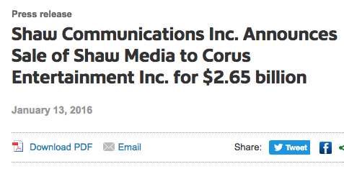
Why is it not a conflict of interest when a Director or CEO benefits from the sale of shares in a takeover that they set up and voted to do?

Slide 43
Answer:
Presumably because it’s “disclosed” in the context…

Slide 44
QUESTIONS? DISCUSSION?

Slide 45
CORPORATE OPPORTUNITIES DOCTRINE

Slide 46
Cook v. Deeks [1916] 1 A.C. 554 (Ont.)
Toronto Construction Co. (“TCC”) had four shareholders (each holding a quarter of the company’s shares) each of whom who were also the directors of that company. TCC helped with railway construction for the CPR.
Three of the directors wanted to exclude the fourth, Mr. Cook, from the business and accordingly agreed to a contract with the CPR for building a line at the Guelph Junction and Hamilton branch in their own three names, and not TCC.
They then passed a shareholder resolution declaring that the company had no interest in that contract between the three and the CPR.
Cook sued arguing that the contract did indeed belong to the Toronto Construction Co. and that the shareholder resolution ratifying the actions of the three other shareholder directors was not valid.

Slide 47
Judicial Committee of the Privy Council found that the three directors had breached their duty of loyalty to the company.
More challenging was how the court would deal with the issue of the shareholder ratification that had occurred given their previous decision in North-West Transportation v. Beatty (1887), 12 APP. CAS. 589 (ONT. J.C.P.C.) where it was decided that in the absence of fraud or oppression a breach of director’s duty to avoid conflict can be “ratified” by a majority of shareholders including the vote of the conflicted director.

Slide 48
The Privy Council drew a distinction between contracting with the corporation as was the case in North-West Transportation (where Mr. Beatty was selling his boat to North-West), and contracting outside the corporation as was the case in Cook v. Deeks (where TCC was not directly involved in the transaction). Make any sense?
The three director/shareholders had to account to TCC for the profits they had made on the contractual opportunity, and those were held in trust for the Toronto Construction Co. (of which you will recall Mr. Cook had a one-quarter interest).

Slide 49
Regal (Hastings) Ltd. v. Gulliver
[1942] 1 All E.R. 378 (House of Lords)
What happens when directors (and a lawyer) acting in good faith and in the best interests of their company follow through personally on a “corporate opportunity”.
Defendants were the directors of Regal (Hastings) Ltd., a company which operated a movie theatre. Regal (Hastings) Ltd. created Hastings Amalgamated Cinemas Limited, intending it to be a subsidiary to acquire two nearby movie theatres the Elite and the De Luxe.
Because of a lack of money at the time in Regal (Hastings) Ltd., the directors and solicitors of Regal (Hastings) Ltd. personally paid for 60% of the shares in Hastings Amalgamated Cinemas Limited. Regal (Hastings) Ltd. had the remaining 40%.
Note that “it was assumed throughout that the defendants acted in the best interests of Regal” .

Slide 50
Ultimately the shares in Regal (Hastings) Ltd. and the 3,000 shares in Hastings Amalgamated Cinemas Limited not owned by Regal (Hastings) Ltd. were sold to Oxford & Berkshire Cinemas Ltd. Part of the consideration was for the 3,000 shares Hastings Amalgamated Cinemas Limited not owned by Regal (Hastings) Ltd. and as a result, the defendants (the directors and solicitors of Regal (Hastings) Ltd. who personally paid for 60% of the shares in Hastings Amalgamated Cinemas Limited) made a profit.
Oxford & Berkshire Cinemas Ltd. now in control of Regal (Hastings) Ltd., caused Regal (Hastings) Ltd. to sue its former directors seeking an account of profits made on the sale of their personal shares in Hastings Amalgamated Cinemas Limited.

Slide 51
Per Lord Russell:“The rule of equity which insists on those who by use of a fiduciary position make a profit, being liable to account for that profit, in no way depends on fraud, or absence of bona fides… The liability arises from the mere fact of a profit having in the stated circumstances been made…
In the result I am of opinion that the directors standing in a fiduciary relationship to Regal in regard to the exercise of their powers as directors, and having obtained these shares by reason and only by reason of the fact that they were directors of Regal and in the course of the execution of that office, are accountable for the profits which they have made out of them...”

Slide 52
Per Lord Wright: “The Court of Appeal held that, in the absence of any dishonest intention, or negligence, or breach of a specific duty to acquire the shares for the appellant company, the respondents as directors were entitled to buy the shares themselves…With the greatest respect, I feel bound to regard such a conclusion as dead in the teeth of the wise and salutary rule so stringently enforced in the authorities. It is suggested that it would have been mere quixotic folly for the four respondents to let such an occasion pass when the appellant company could not avail itself of it; Lord King, L.C., faced that very position when he accepted that the person in the fiduciary position might be the only person in the world who could not avail himself of the opportunity.”

Slide 53
Per Lord Porter: “In these circumstances it is to my mind immaterial that the directors saw no way of raising the money save from amongst themselves and from the solicitor to the company, or indeed that the money could in fact have been raised in no other way. The legal proposition may, I think, be broadly stated by saying that one occupying a position of trust must not make a profit which he can acquire only by use of his fiduciary position, or if he does he must account for the profit so made…
…Directors, no doubt, are not trustees, but they occupy a fiduciary position towards the company whose board they form. Their liability in this respect does not depend upon breach of duty but upon the proposition that a director must not make a profit out of property acquired by reason of his relationship to the company of which he is director. It matters not that he could not have acquired the property for the company itself - the profit which he makes is the company’s, even though the property by means of which he made it was not and could not have, been acquired on its behalf...”

Slide 54
Peso Silver Mines v. Cropper [1966] S.C.R. 673
A prospector, Mr. Dickson, owned a number of mineral claims one of which was adjacent to claims held by Peso Silver Mines.
Dickson offered to sell them to Peso Silver Mines, but the offer was rejected by the Peso Silver Mines board.
Subsequently, three other investors approached Mr. Cropper who was the managing director of Peso Silver Mines and member of its board, and the four of them formed a private company that acquired Mr. Dickson’s claims and developed them. Control of Peso Silver Mines subsequently changed hands.
The newly reconstituted Peso Silver Mines sued Mr. Cropper seeking to purchase his holdings in the now profitable mine at Mr. Cropper’s cost, or to account for the proceeds of the transaction.

Slide 55
What happened to “strict”?
Note defendants in Peso Silver Mines v. Cropper had acted entirely in good faith in connection with the board’s decision not to pursue an opportunity.
Therefore SCC found that they could arrange for their own separate company to take the opportunity represented by Mr. Dickson’s claims perfectly lawfully.
And they could keep the resulting profits. There had been a valid rejection of a business opportunity executed in good faith with appropriate procedures by Peso Silver Mines through it’s Board.
Accordingly a director acting in his personal capacity could take the opportunity perfectly lawfully at a later time.

Slide 56
Cartwright J.
“…I find it impossible to say that the respondent obtained the interests he holds in Cross Bow and Mayo by reason of the fact that he was a director of the appellant and in the course of the execution of that office.
When Dickson…offered his claims to the appellant it was the duty of the respondent as director to take part in the decision of the board as to whether that offer should be accepted or rejected. At that point he stood in a fiduciary relationship to the appellant. There are affirmative findings of fact that he and his co-directors acted in good faith, solely in the interests of the appellant and with sound business reasons in rejecting the offer. There is no suggestion in the evidence that the offer to the appellant was accompanied by any confidential information unavailable to any prospective purchaser or that the respondent as director had access to any such information by reason of his office. When, later, Dr. Aho approached the appellant it was not in his capacity as a director of the appellant, but as an individual member of the public...”

Slide 57
Industrial Development Consultants Ltd. v. Cooley [1972] 2 All E.R. 162
Cooley was a distinguished architect who was employed as the managing director of Industrial Development Consultants Ltd., the plaintiff.
Cooley tried on behalf of Industrial Development Consultants Ltd. to negotiate a contract to design a depot in Letchworth with the Eastern Gas Board. The negotiation was unsuccessful and Eastern Gas Board advised Cooley that they did not want to contract with Industrial Development Consultants Ltd., but only with him.
Cooley then told the board of Industrial Development Consultants Ltd., that he was unwell and asked to resign from his job on early notice. The board accepted Mr. Cooley’s resignation.
Cooley then took on the work of design a depot in Letchworth for the Eastern Gas Board on his own account.
Industrial Development Consultants Ltd. subsequently discovered this and sued Mr. Cooley for breach of his duty of loyalty. Cooley was found liable.

Slide 58
Why was Cooley found liable? Factors:
When Cooley acquired knowledge of the Eastern Gas Board interest in him as the designer of the depot in Letchworth, Industrial Development Consultants Ltd. did not have that knowledge and would have wanted it.
The information came to Cooley at a time when Cooley had only one single capacity – as a director of Industrial Development Consultants Ltd..
The fact that Industrial Development Consultants Ltd. could not or would not have obtained the benefit is irrelevant.
It is irrelevant that if Cooley is found liable the net effect would be that Industrial Development Consultants Ltd. would obtain a benefit that, by definition, it could not otherwise have obtained.

Slide 59
Gravino v. Enerchem Transport Inc. [2008] J.Q. NO 9347 (QUE. C.A.)
Ultramar began negotiations with Enerchem Transport Inc. (“ETI”), for the subchartering by ETI of three Ultramar tankers.
Gravino and Carson were at the time shareholders and directors of ETI and actively participated in the negotiations with Ultramar.
No agreement reached. Subsequently Gravino & Carson sold their ETI shares and a later they ended their employment with ETI.
There was no non-compete clause.

Slide 60
Following their departure, Gravino and Carson founded Petro-Nav Inc., a company that competed directly with ETI. They also recruited from ETI its then vice president marketing, Marian Zaremba, to join Petro-Nav Inc.
Almost a year later, Ultramar assigned its lease agreement over the tankers Mr. Gravino and Mr. Carson had previously attempted to negotiate for while directors and shareholders of ETI, to a subsidiary of Petro-Nav Inc.
ETI alleged that its former directors and officers had appropriated to themselves a business opportunity they had developed on behalf of their former employer, and that accordingly Gravino and Carson had breached their duty of loyalty to ETI.

Slide 61
Observations on the Judgment…
Duty of loyalty owed to ETI by its ex-officers in this case was all the greater given the high level of responsibility associated with the positions they had held in ETI.
On the topic of a “maturing business opportunity” it is clear that a director cannot use for their own profit or that of a third party any information obtained by reason of their duties, unless authorized to do so.

Slide 62
The test…
Four main factors to be weighed in order to determine whether misappropriation of a business opportunity has taken place:
i) the degree to which the interests of the director and the interests of the company were in conflict,
ii) the degree to which the business opportunity had, at the time in question, acquired its own specific and identifiable character,
iii) the proximity in time between the emergence of the business opportunity and its exploitation, and
iv) the proximity in character between the business opportunity pursued by the company and the contract or business concluded by the director for his own profit or the profit of a third party.

Slide 63
Most important factors when it comes to the application of the duty of loyalty to corporate opportunities…
The facts;
The facts; &
The facts.

Slide 64
CONFLICTS OF DUTY AND DUTY

Slide 65
Conflict of Duty and Duty
Issue of having duties of loyalty to two different companies when you are a board member of both is not unknown.
No easy solutions apart from resignation from one the companies or possibly both depending on the circumstances.
Most useful strategic mechanism is to use the principle of “informed consent” liberally.
Could go as far as obtaining a waiver from both companies respecting any potential conflict (much as lawyers do when asked to advise different parties who might have divergent interests in the same matter).

Slide 66
The saving grace of Ratification ?
Ratification by the shareholders is a tool often used to retroactively remedy mistakes that have been made.
In Regal (Hastings) Ltd. v. Gulliver the directors and solicitors of Regal, acting in the best interests of Regal, personally paid for 60% of the shares to acquire two movie houses because Regal did not at the time have the funds to do so.
There Lord Russell observed that the directors “…could, had they wished, have protected themselves by a resolution (either antecedent or subsequent) of the Regal shareholders in general meeting.”

Slide 67
Bamford v. Bamford [1969] 1 All E.R. 969(C.A.)
Harman L.J. “It is trite law… that if directors do acts, as they do every day, especially in private companies, which, perhaps because there is no quorum, or because their appointment was defective, or because some-times there are no directors properly appointed at all, or because they are actuated by improper motives, they go on doing for years, carrying on the business of the company in the way in which, if properly constituted, they should carry it on, and then they find that everything has been so to speak wrongly done because it was not done by a proper board, such directors can, by making a full and frank disclosure and calling together the general body of the shareholders, obtain absolution and forgiveness of their sins; and provided the acts are not ultra vires the company as a whole everything will go on as if it had been all right from the beginning…Of course, if the majority of the general meeting will not forgive and approve, then the directors must pay for it.”

Slide 68
Evidence of shareholder approval of ratification is admissible but not decisive
BCBCA 233 (6): No application made or legal proceeding prosecuted or defended under section 232 or this section may be stayed or dismissed merely because it is shown that an alleged breach of a right, duty or obligation owed to the company has been or might be approved by the shareholders of the company, but evidence of that approval or possible approval may be taken into account by the court in making an order under section 232 or this section.
CBCA 242 (1): An application made or an action brought or intervened in under this Part shall not be stayed or dismissed by reason only that it is shown that an alleged breach of a right or duty owed to the corporation or its subsidiary has been or may be approved by the shareholders of such body corporate, but evidence of approval by the shareholders may be taken into account by the court in making an order…”

Slide 69
TAKE-OVER BIDS

Slide 70
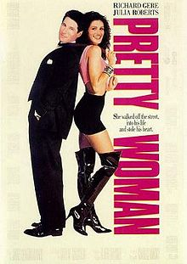
Worst film about takeover bids…EVER

Slide 71
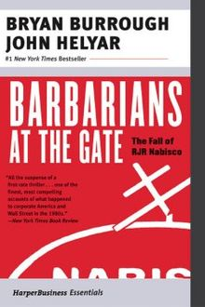
The (multi-million dollar) question is what is the duty of directors to their corporation when confronted with a take-over? And do the directors owe any duties to shareholders?
Published 1989

Slide 72
Olympia and York Enterprises Ltd. v. Hiram Walker Resouces Ltd. (1986), 59 O.R. (2d) 254 (H.C.J.)
Gulf Canada decided it wished to acquire a majority shareholder interest in Hiram Walker Resources Ltd.
Gulf offered $32 per share for 39% of the shares. Directors of Hiram Walker Resources Ltd. decide to employ a defensive tactic to stop Gulf Canada by selling the liquor business of Hiram Walker Resources Ltd. representing 40% of the company’s total assets to Allied Lyons for $2.6 billion.
Hiram Walker Resources Ltd. used that money to pay for 49% of the shares in a new subsidiary, “Fingas” which then bid $40 per share for 48% of Hiram Walker Resources Ltd. (much higher in price and percentage over the Gulf Canada bid).
Olympia &York Enterprises Ltd. was the parent company of Gulf Canada and sought to enjoin sale of the liquor business of Hiram Walker to Allied Lyons. They argued that the directors of Hiram Walker Resources Ltd. were using corporate assets for the purpose of entrenching themselves in the management of the corporation, and accordingly were in breach of their fiduciary duties.

Slide 73
Montgomery J. dismissed the application of Olympia &York Enterprises Ltd.
Court found the directors were not proposing to buy back the shares of Hiram Walker with corporate assets so as to entrench themselves.
Montgomery J. found that on the evidence the directors acted prudently, properly, reasonably and fairly on the advice of their legal and financial advisors, the opinion of management and their collective store of business acumen.
It was also seen as a legitimate objective to ensure that as much as possible of all “economic value” be distributed to all of the shareholders and not just Gulf Canada/Olympia & York. Montgomery J…“I am satisfied on the basis of the affidavits of Mr. Downing and Mr. Lambert that the sole purpose of the conduct of the directors of Hiram Walker was to maximize the position of all their shareholders after Gulf’s takeover bid…”

Slide 74
Principles of Olympia & York
When directors act in the best interests of the company and in good faith, it matters not that they also benefit from their action (in this case by becoming more entrenched in the company). In other words self-entrenchment will not necessarily be inferred where retaining control is secondary to the more important purpose of acting in good faith and in the company best interests.
It is the duty of the directors in a take-over battle to take all reasonable steps to maximize shareholders value. In maximizing shareholder value directors may rely on professional advice as to the adequacy of a bid, and that such reliance will be evidence of acting in good faith and on reasonable grounds.

Slide 75
Context…
The "insider" affidavit is supplemented by the affidavit of Allen T. Lambert, an "outside" director…The extent of his independence and his business acumen may be drawn from his corporate involvement. Between 1961 and 1978 he was president and/or C.E.O. of the Toronto-Dominion Bank. He is presently chairman and a director of Trilon Financial Corporation, London Life Insurance Company and Hudson Bay Mining…
Mr. Lambert attended the four meetings previously referred to. He also confirms that at the outset of each meeting the board was advised of the directors' obligation to act in the best interest of the shareholders of Hiram Walker with respect to the Gulf offer…Mr. Lambert states that this decision represented the best exercise of his business judgment. Mr. Lambert says it was made solely in the best interest of shareholders and not in any way for the purpose of entrenching management.

Slide 76
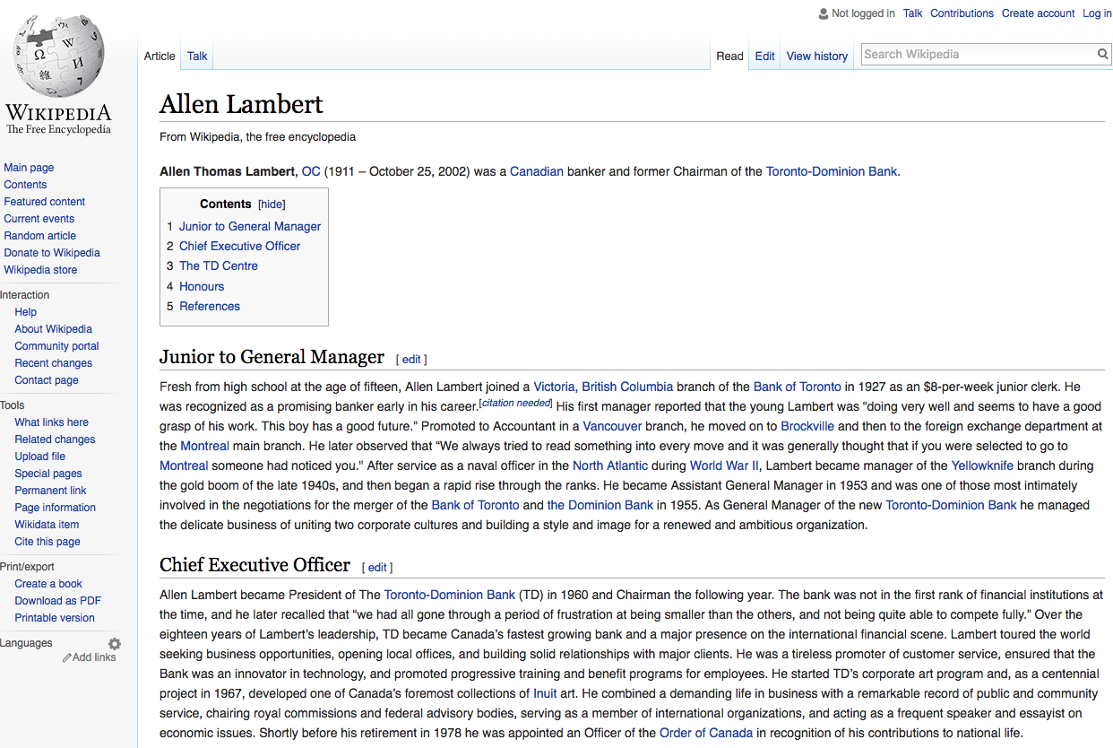
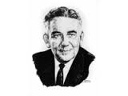

Slide 77

Difference between…
Taking reasonable steps to maximize shareholders value in the context of the best interests of the company
& Directors obligation where a company is for sale to conduct an auction of the company’s shares.

Slide 78
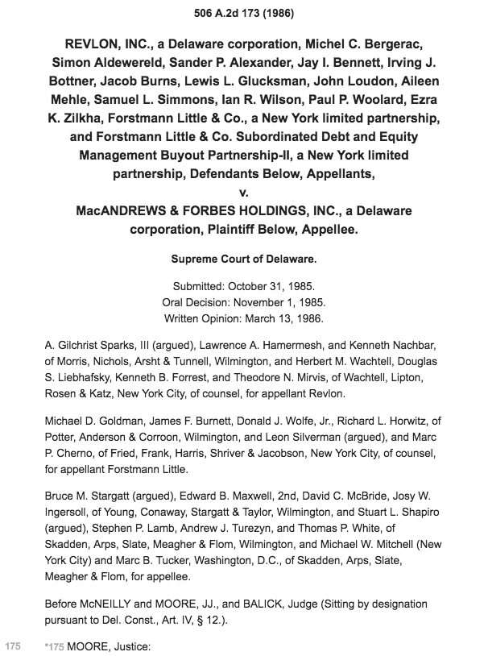
The Revlon Principle (NOT OUR LAW)

Slide 79
QUESTIONS? DISCUSSION?

Slide 80
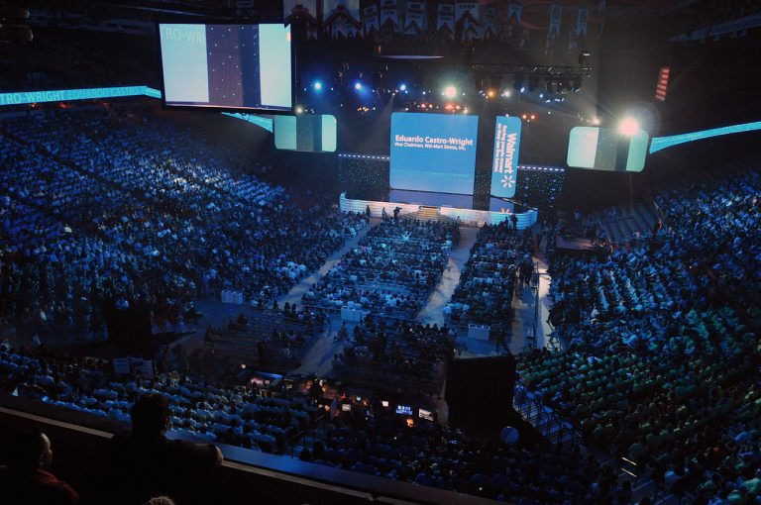
Coming Wednesday
MAJORITY RULE & PROTECTING MINORITY INTERESTS

Slide 81

Do I have “fi-cat-iary” obligations?

