Slide 1


EXAM PREP. 101
Talk 23
LAW 459 003
BUSINESS ORGANIZATIONS
Allard School of Law, UBC
Fall, 2016
Jon Festinger Q.C.
Festinger Law & Strategy
http://bizorg.allard.ubc.ca
@jonfestinger
jon@fblawstrategy.com

Slide 2
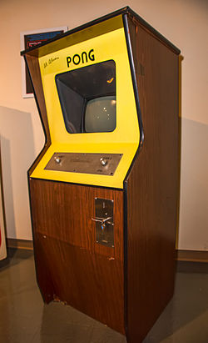
Happy November 29
LAW 459 003
BUSINESS ORGANIZATIONS
44 years ago today co-founder of Atari, Nolan Bushnell releases Pong, the first commercially successful video game in Andy Capp's Tavern in Sunnyvale, California.

Slide 3
Evaluations
Online at
https://eval.ctlt.ubc.ca/law until Monday December 5 @ 11:59 PM

Slide 4
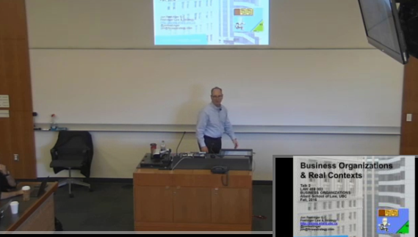
Not Lecture Capture Tuesday

Slide 5
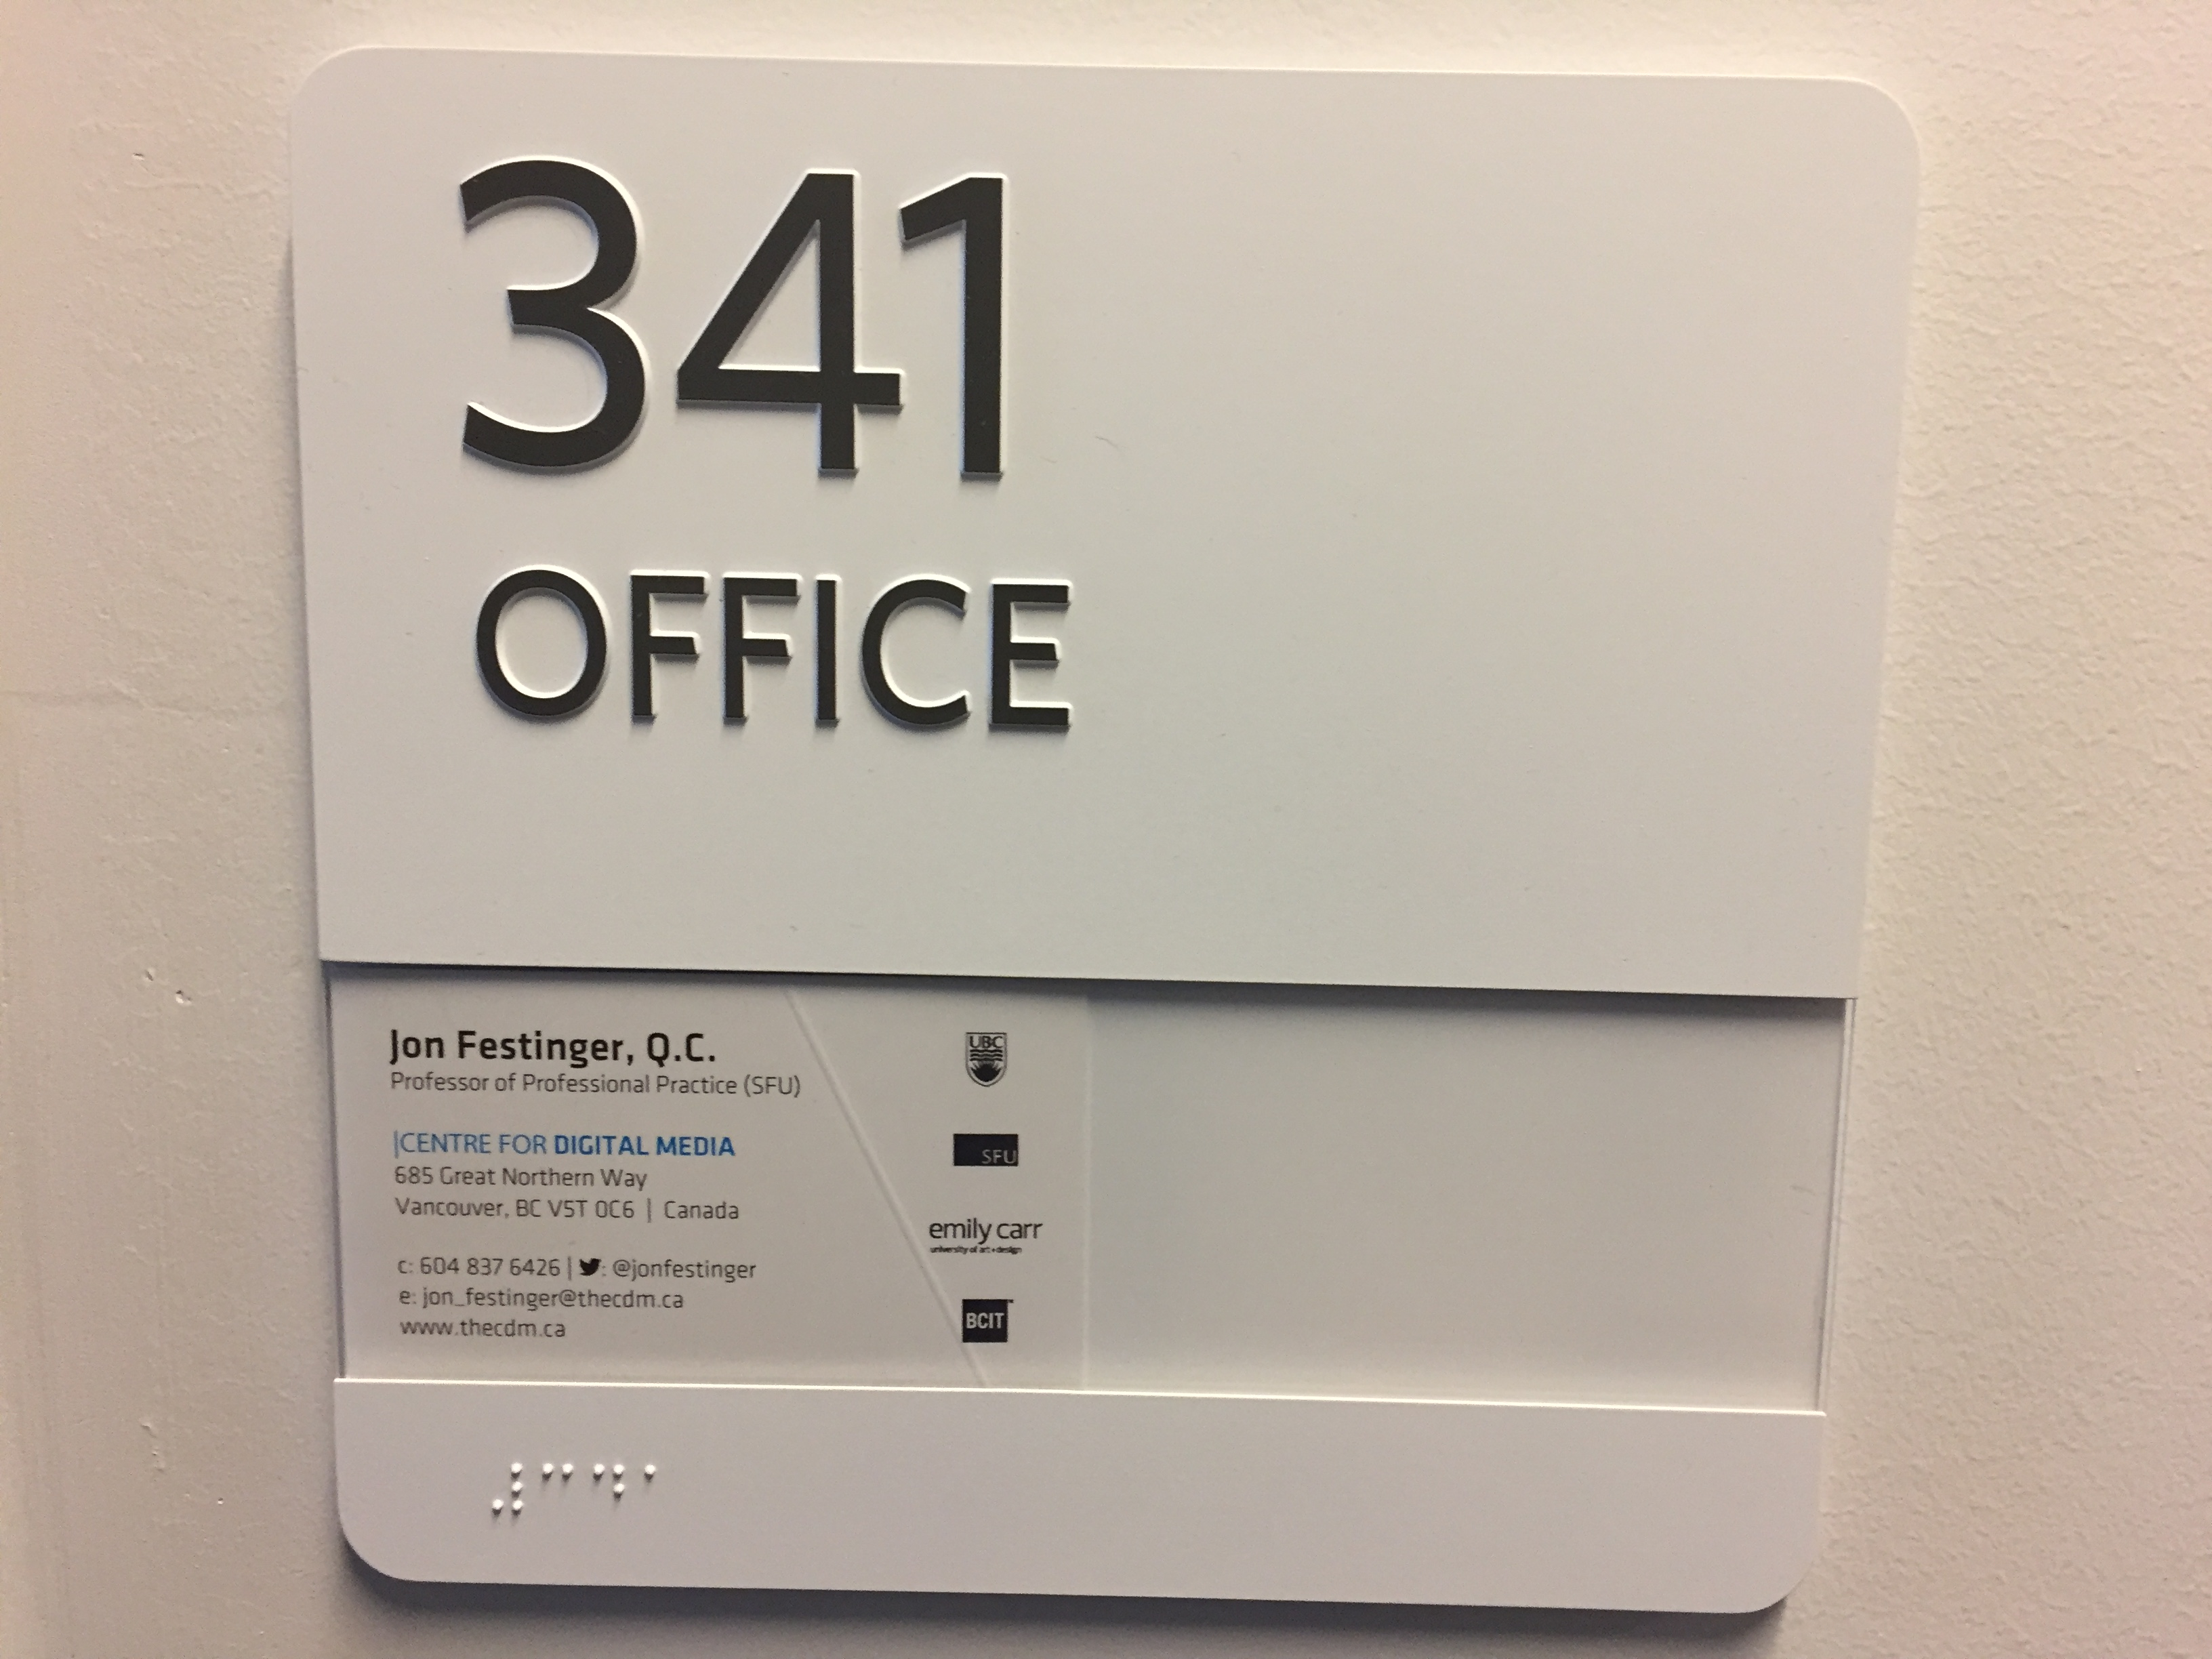
Office “Hours” during exams
Email me & am happy to come to Allard: jfestinger@telus.net
Skype: jon.festinger
Phone:
o. 604-568-9192
c. 604-837-6426

Slide 6
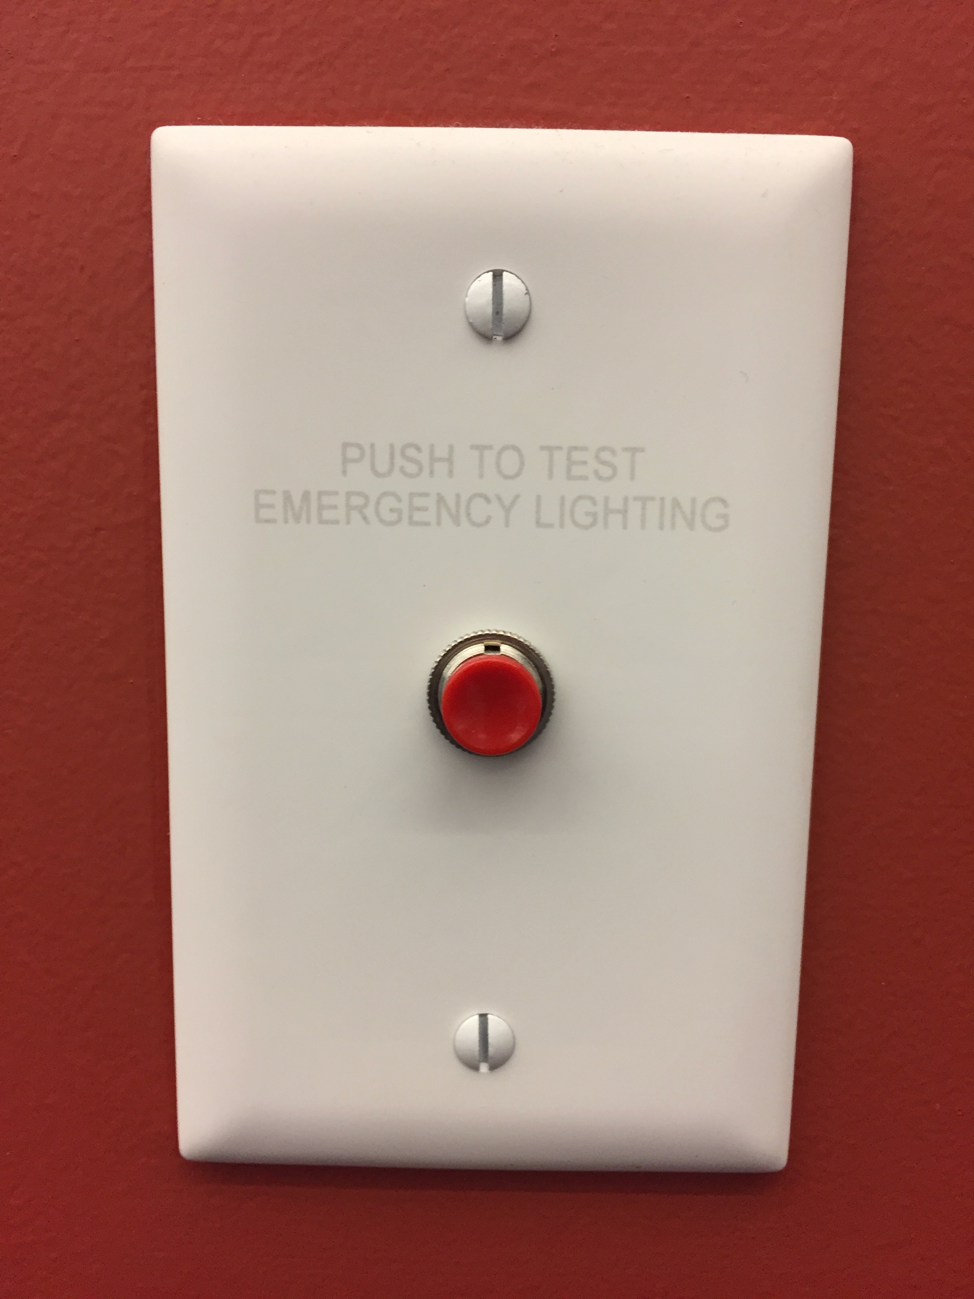
Exam Prep

Slide 7
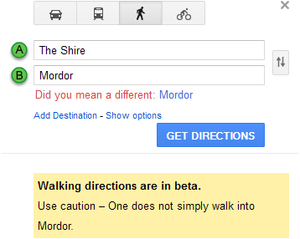
Look for “Easter Eggs”

Slide 8

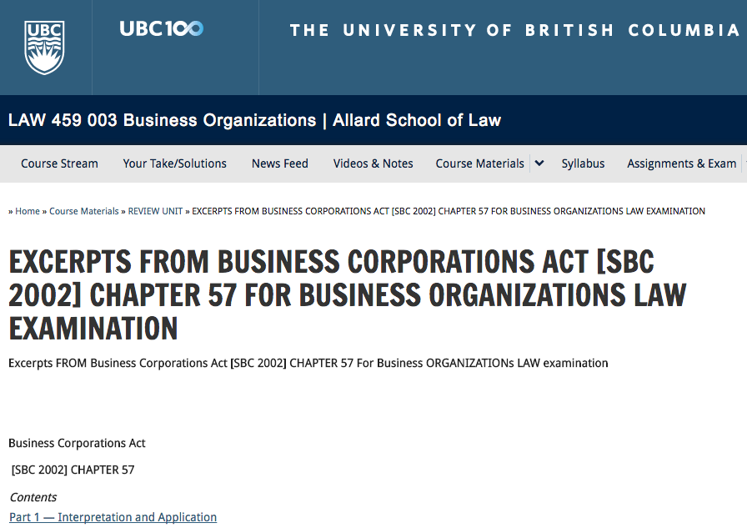
AFRAID YOU HAVE TO BRING YOUR OWN STATUTES

Slide 9
Unit 8: What you need to know…
BCBCA sections 227-228, 231-236; [CBCA section 241]
What is the “oppression” remedy (s. 227 & 228) and it’s mechanics?
Enforcement of duty to file records (s.231)
What is a “derivative action” (s. 232 -236) & what are it’s mechanics?
Robak Industries Ltd. v. Gardner 2007 BCCA 61

Slide 10
The usefulness of “remedies”
There is very little if anything directly dealing with Chapter 8 on the exam. However to the extent Chapter 8 deals with forms of remedies, those can always be helpful in an exam response to “show what you know”.

Slide 11
Rest of Unit 8
Chronicles notorious corporate scandals → interesting and all about ethics
We have done a lot on ethics throughout the course (discussions in first few weeks and Assignment 2)
In actual practice, you can never know too much about ethics and governance.
Your fear is probably not knowing the right section to do the right thing for your client. You will. I promise. Practice is an open-book exam.
My fear for you is that you won’t be able to locate the right ethical context for the situation you and your clients are in. That’s far more likely to land you in hot water and severe consequences.

Slide 12
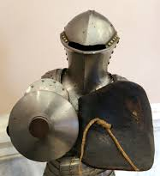
Only other place “rest” of Unit 8 may be helpful (but not necessary) on the exam…
As context if you are making a policy argument regarding piercing the corporate veil .

Slide 13
THE EXAM ITSELF
3 hour open book (+ 30 minutes of reading time ?)
Worth 50% of your course mark, so will be marked out of one hundred (much fairer than odd percentages IMHO)
2 questions (sort of)
1st question is a lengthy fact pattern primarily dealing with Directors having differing views.

Slide 14
1st question has three parts worth 70% of the exam. The sections are:
First section in memo form = 20%
Second section involves specific questions where you are led to the most relevant sections of the BCBCA as your starting point = 30%
Third section re what actions & remedies – who can do what to whom = 20%

Slide 15
The Fact Pattern
Deals with a dispute among directors
Parent/subsidiary
What is in the “Best interests of the company…”?
Roles and duties of management
Roles and duties of directors
Roles and duties of special committees (tomorrow – in Unit 7)
Roles of shareholders
Who is wearing what “hat” when?

Slide 16
Focus (but not exclusively) on:
Inter-relationships of Articles of a company and statutory provisions
Shareholder proposals
Conflicts of interest
Duties in a takeover scenario
Shares & their transferability
About how would you argue principles and apply them

Slide 17
2nd Question = 30%
Statutory drafting exercise with explanations…
Choice of statute you want to draft for
Do you believe such a provision is useful, necessary or helpful?
Which substantive elements would you include in such a provision
First draft

Slide 18
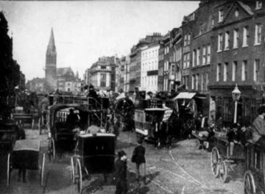
Always remember…
What is the context?
Is there “wrongdoing”?

Slide 19
QUESTIONS? DISCUSSION?

Slide 20

Do I have “fi-cat-iary” obligations?

